Slide 1


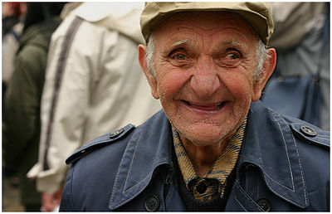
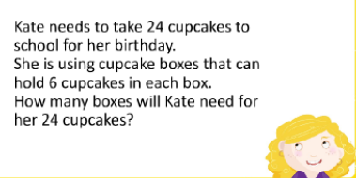
Good Morning Year 3 01.03.21
Write a sentence using the word of the day.
2. Write a list of as many compliments as you can think of. Try and use them today with the people around you. Tick them off once you have said them and see how many you managed to use. What did they say? How did you make them feel?
3.
Don’t forget to tune into Mrs Bryden’s last ‘Shout Out’ assembly.
Monday 1st March
DID YOU KNOW?
March 1st is…
World Compliment Day
Word of the Day!
abolish a-bol-ish
To do away with (laws, regulations, customs); put an end to.
The teacher abolished running in school
Can you use this in your English work? Or in a conversation today?
Remember to still complete today
15 minutes of TTROCKSTAR.
Reading for 10 minutes.

Slide 2
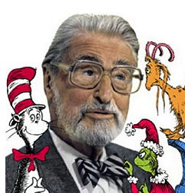
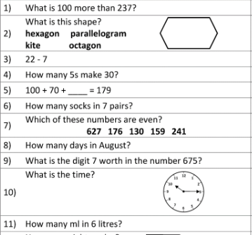
Tuesday 2nd March
Good Morning Year 3 02.03.21
Write a sentence using the word of the day.
DID YOU KNOW?
March 2nd is…
Dr Seuss Day
Word of the Day!
explanation ex-pla-na-tion
You give details about it or describe it so it can be understood.
Jim gave a poor explanation for why he was late.
Can you use this in your English work? Or in a conversation today?
Remember, no Zoom Circle Time sessions this afternoon. We will have a session on Thursday afternoon instead.
Y
Remember to still complete today
15 minutes of TTROCKSTAR.
Reading for 10 minutes.

Slide 3
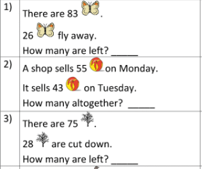
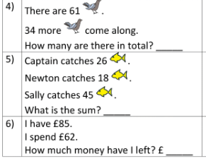
Good Morning Year 3 03.03.21
Write a sentence using the word of the day.
What wildlife can you see from your window. Sit quietly for a few minutes looking out. What do you notice?
.
Wednesday 3rd March
DID YOU KNOW?
March 3rd is…
World Wildlife Day
Word of the Day!
flock flock
A group of people or things as a flock of them to emphasize there are lots of them.
The flock of teachers gathered around the biscuits.
Can you use this in your English work? Or in a conversation today?
Remember to still complete today
15 minutes of TTROCKSTAR.
Reading for 10 minutes.

Slide 4



Good Morning Year 3 04.03.21
Write a sentence using the word of the day.
Check the timetable for today. The timings are slightly different to normal. Start on some of the activities.
Read your AR book and take a test if you need to.
Go on Spelling Shed.
Don’t forget Mrs Bryden is doing an assembly at 9.05a.m.
Thursday 4th March
DID YOU KNOW?
March 4th is…
World Book Day
Word of the Day!
diagram di-a-gram
A simple drawing which consists mainly of lines and is used to show information.
The diagram shows the classes favourite ice cream.
Can you use this in your English work? Or in a conversation today?
Remember to still complete today
15 minutes of TTROCKSTAR.
Reading for 10 minutes.

Slide 5


Friday 5th March
Good Morning Year 3 05.03.21
1. Write a sentence using the word of the day.
2. As a Year 3, how much grammar do you already know and understand? We have learned and practised a lot of grammar in our Tuesday English sessions this term. You could start with verbs, nouns and adjectives. Can you write their explanations?
3.
DID YOU KNOW?
March 5th is…
Grammar Day
Word of the Day!
analyse an-a-lyse
You consider it carefully to fully understand it.
We analysed the numbers to calculate the answer.
Can you use this in your English work? Or in a conversation today?
Remember to still complete today
15 minutes of TTROCKSTAR.
Reading for 10 minutes.
Now make up some of your own.
C

