Slide 1
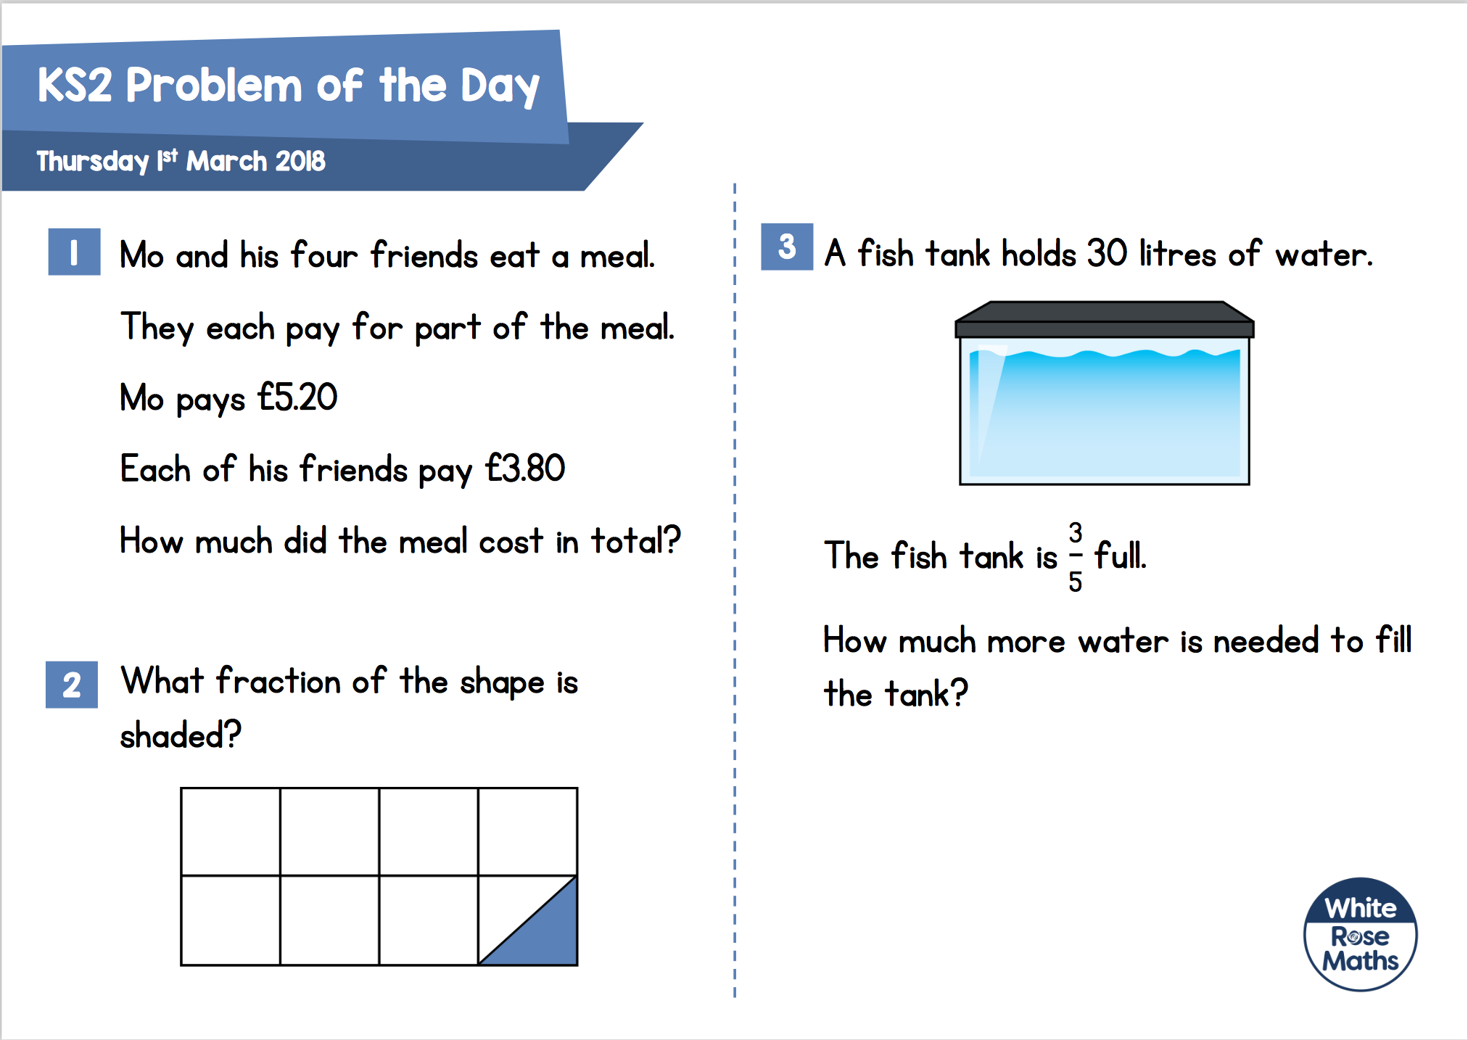

£20.40
12 litres
$$\frac{\text{1}}{\text{16}}$$

Slide 2
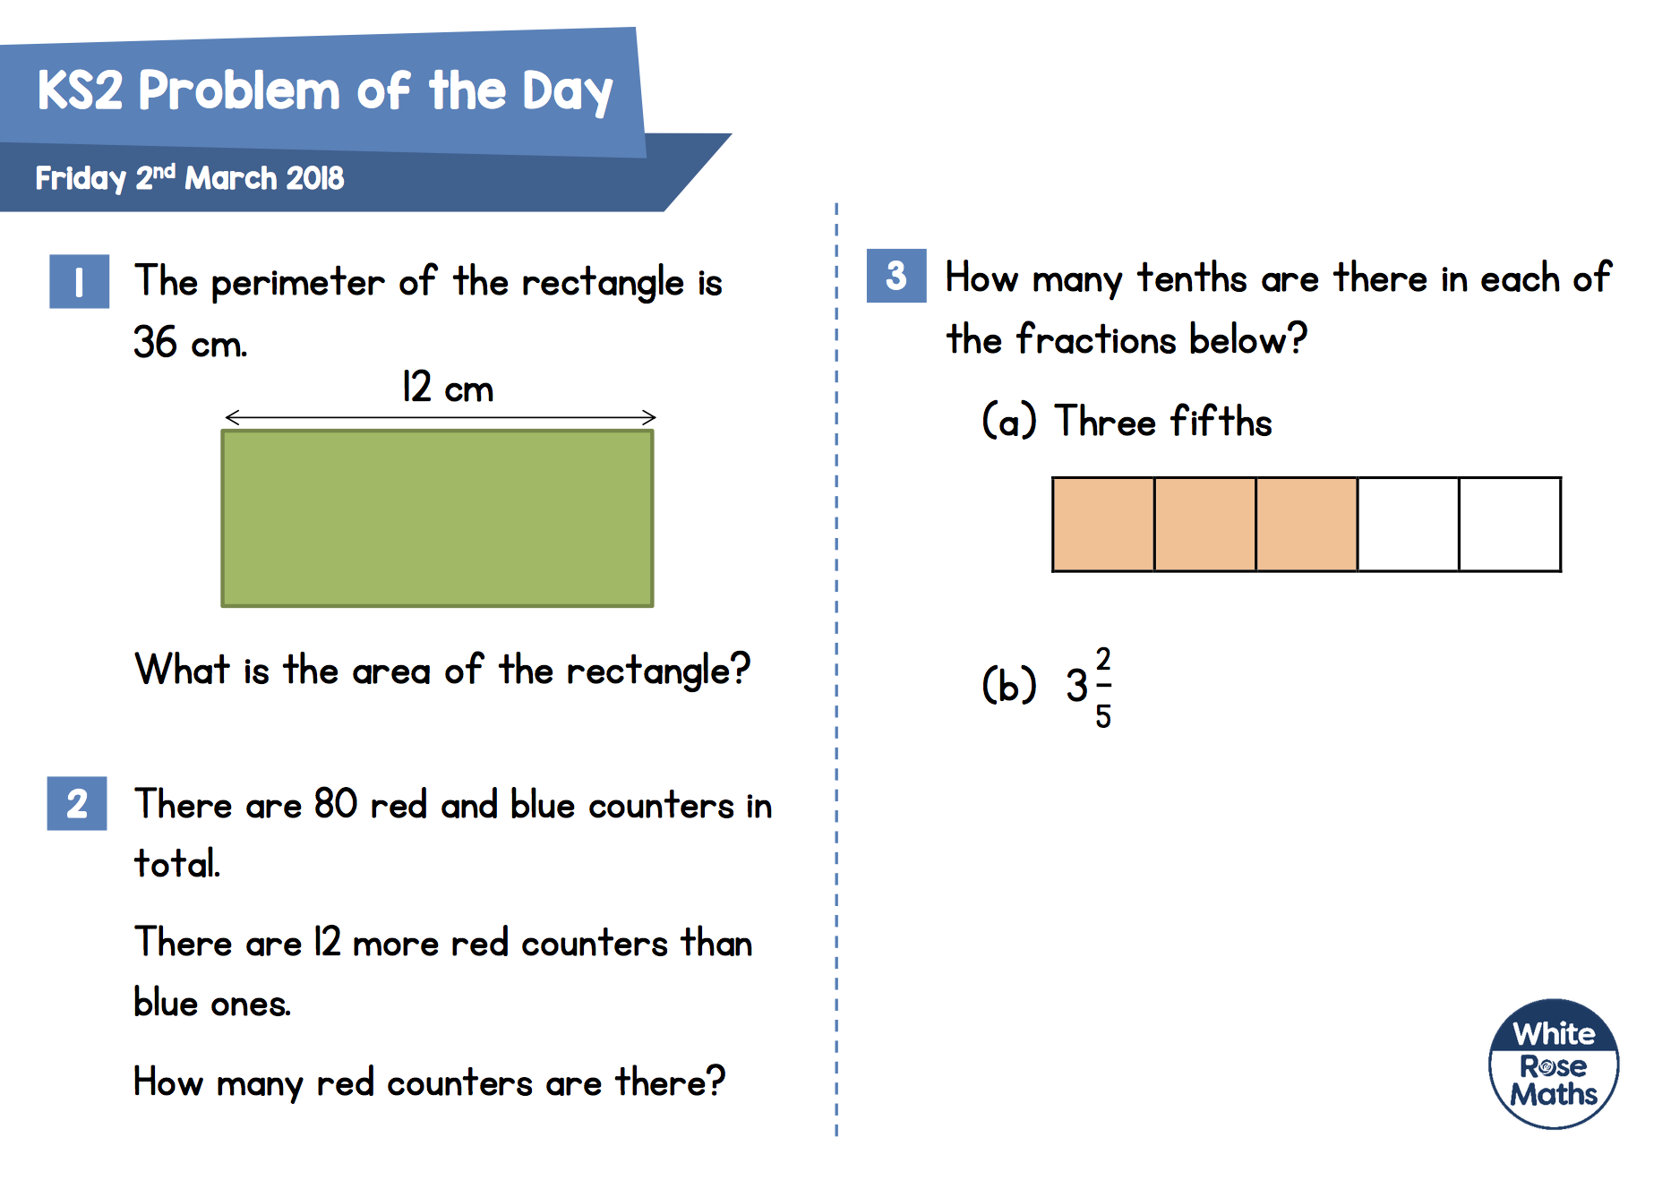



$$\frac{\text{6}}{\text{10}}$$
$$\frac{\text{34}}{\text{10}}$$
72 ${cm}^{2}$
46

Slide 3
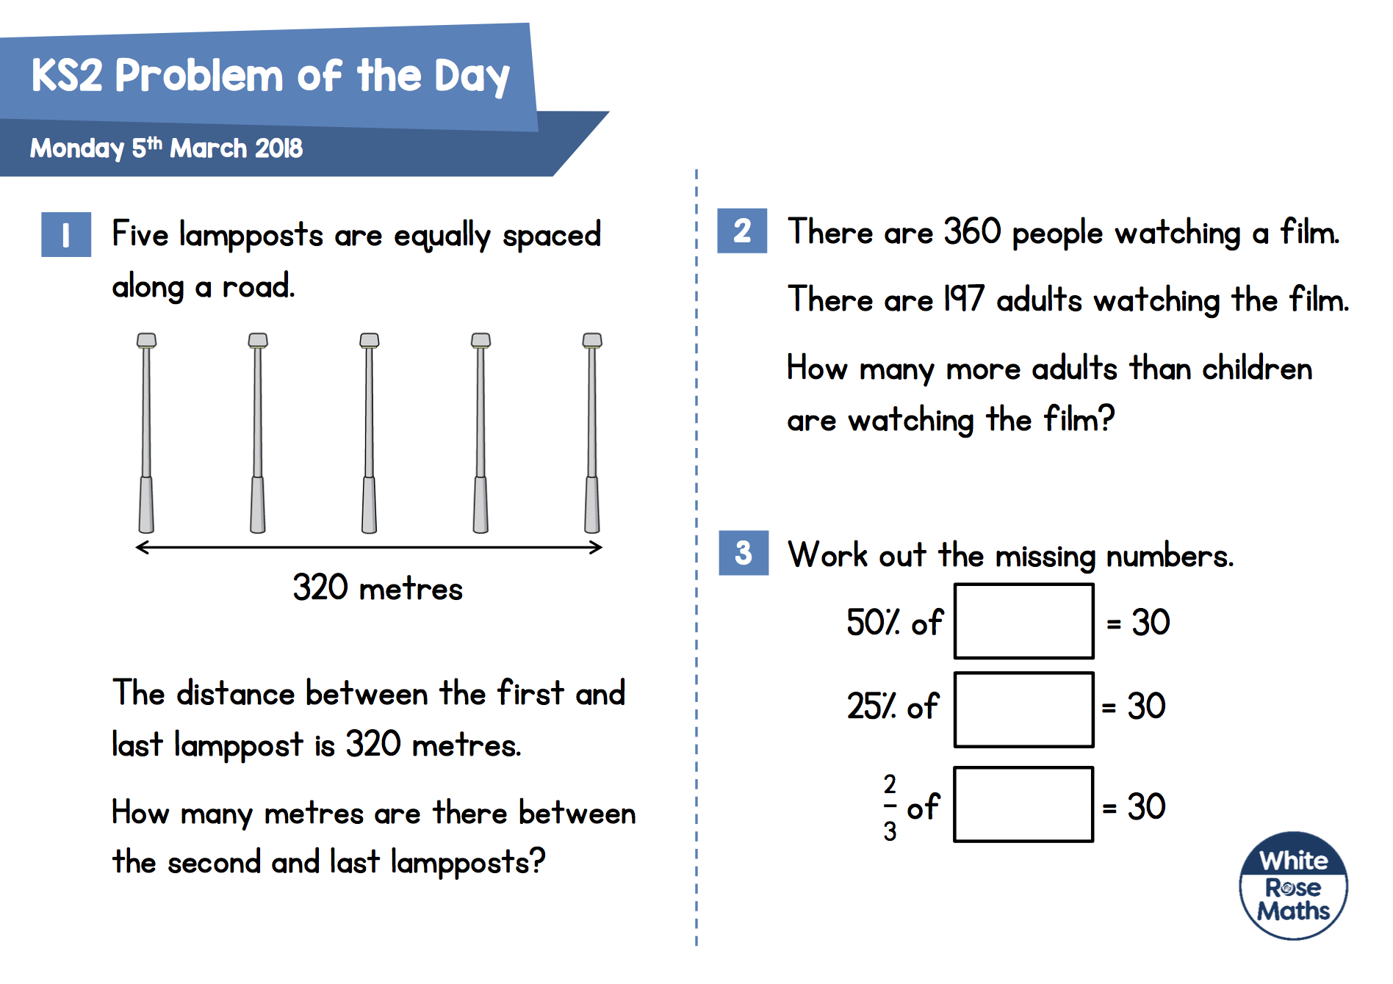
34
60
120
45
240 m

Slide 4
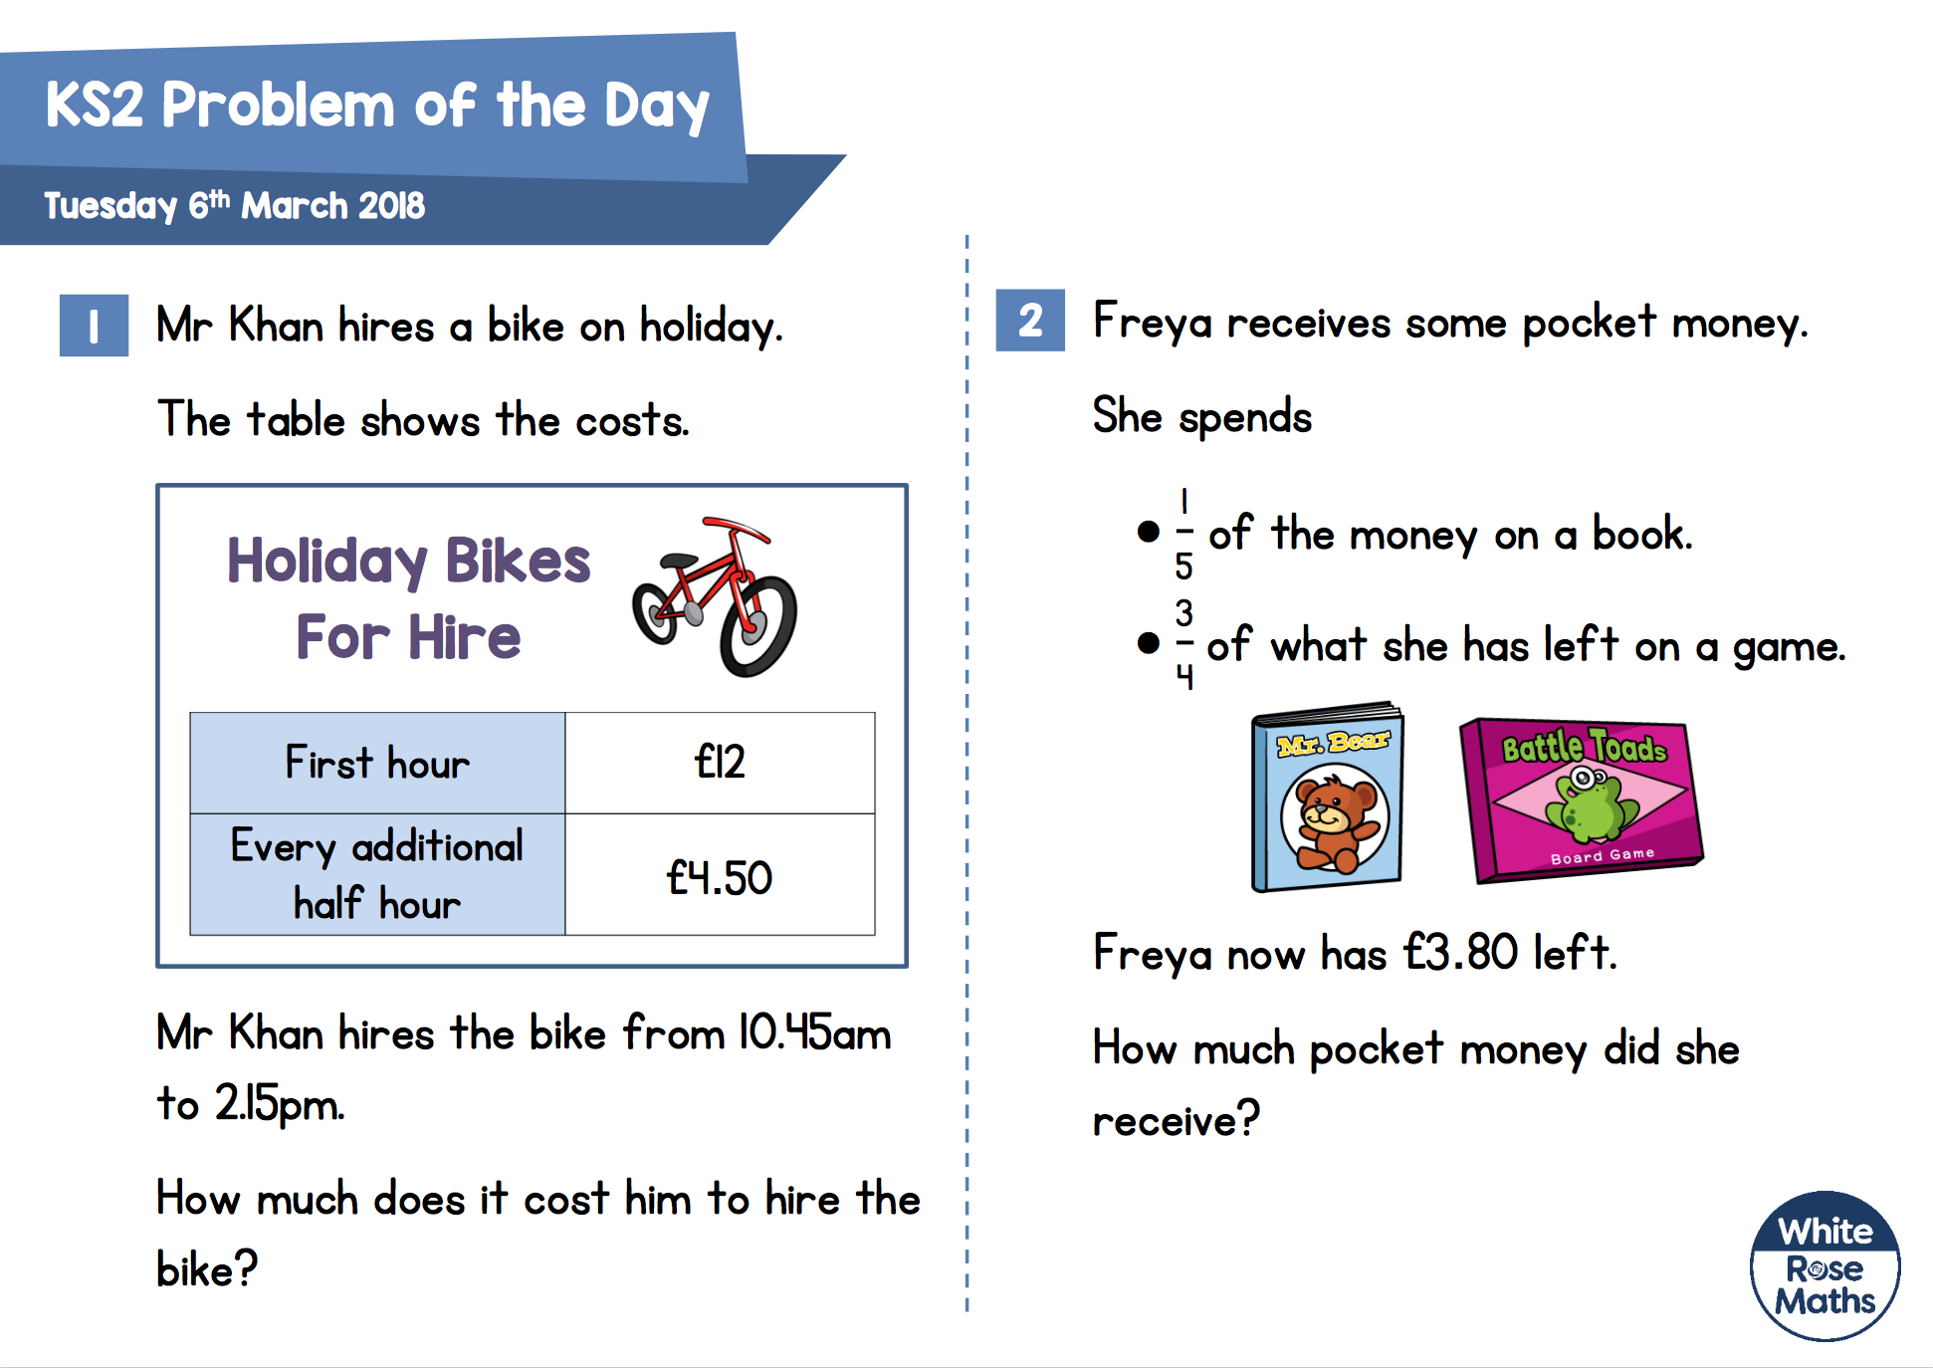
£19
£34.50

Slide 5
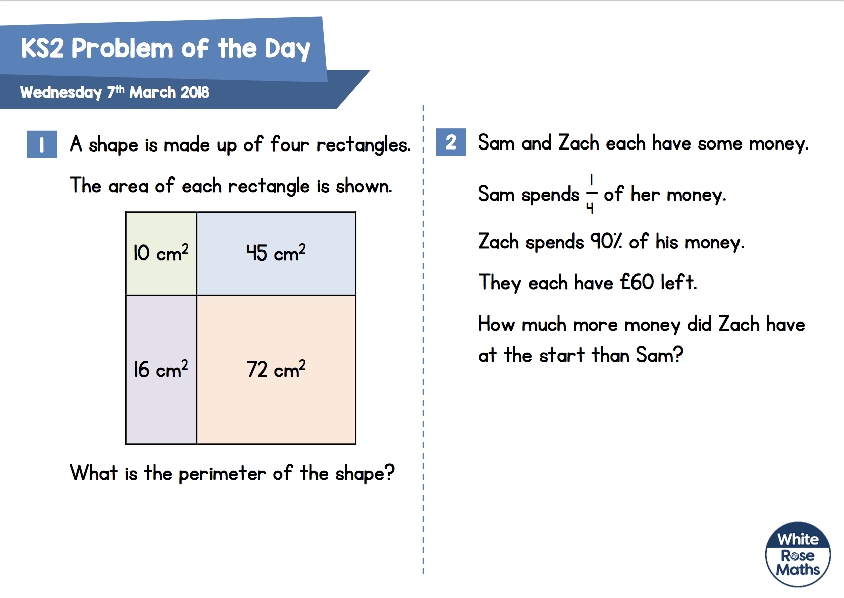
5 cm
8 cm
£520
2 cm
9 cm
48 cm

