Slide 1

Key Stage Two SATs
Monday 11th May – Thursday 14th May

Slide 2
What are SATs?
Standard Assessment Tests
They are used to assess a child’s understanding of the KS2 curriculum (Year 3-6) and the progress they have made.
The tests feature assessment of learning from across the key stage, not just Year 6.

Slide 3
What are SATs?
All Year 6 pupils take sit these papers in the same week.
They take place in the classroom, just like any other assessment week at school.
These tests cannot be failed – they are checking progress against the curriculum.

Slide 4
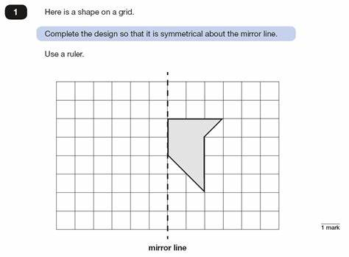
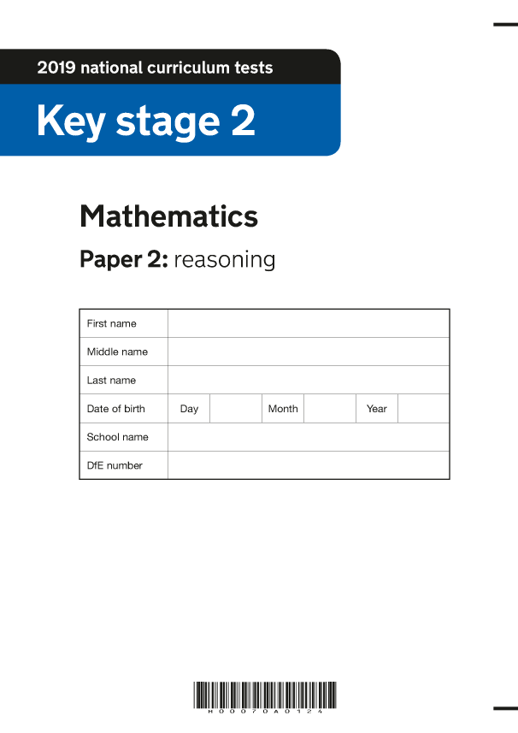

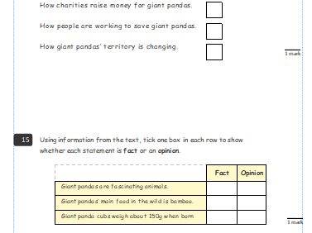
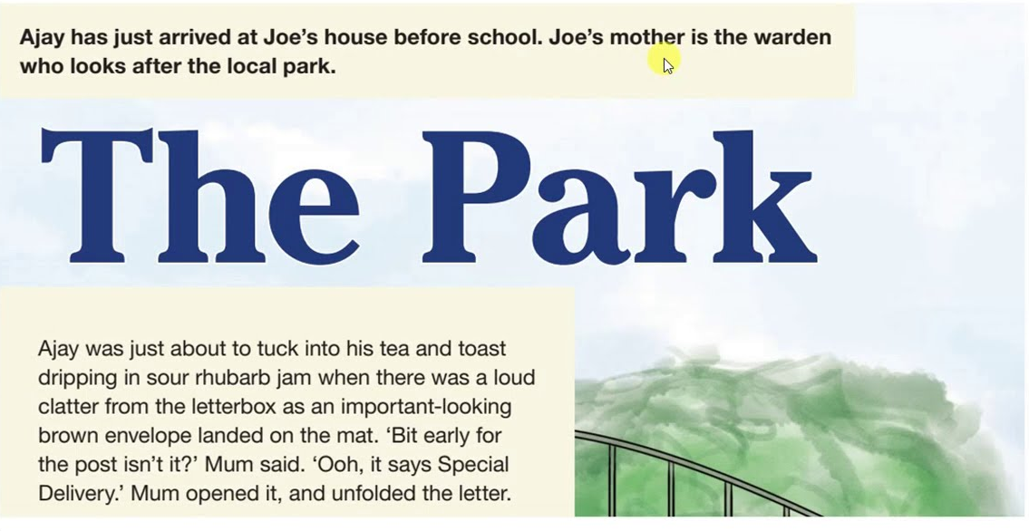
What are SATs?

Slide 5
Timetable
Day | Paper
Monday 11th | Punctuation and Grammar (45 minutes) Spelling
Tuesday 12th | Reading (60 minutes)
Wednesday 13th | Maths 1 – Arithmetic (30 minutes) Maths 2 – Reasoning (40 minutes)
Thursday 14th | Maths 3 – Reasoning (40 minutes)

Slide 6
Access arrangements
Some children qualify for support to help them access the test papers.
This can be based on a number of different criteria, such as reading speed, writing speed and cognition.
Children will be spoken to about the support they will receive so they understand how it will work.
This support can range from extra time (25%), a reader, a prompter or a space outside of the classroom.
There will be plenty of adults in the classroom to support all of the children. We promote having questions read out loud by an adult to support understanding.

Slide 7
How the week works
The children will be invited to attend the SATs breakfast.
  - A letter will be sent out with exact timings
  - Children enter the school at the main entrance
  - In the hall, breakfast will be given to the children each morning before they sit the paper
After the papers, there will be revision sessions for the next day’s papers
The children will have lots of opportunities for sport/mindfulness/art through the week.

Slide 8
What SATs are not…
High pressure, high stakes tests.
The only way that children are put into sets/classes for secondary school (Year 6 teachers speak directly to secondary schools to inform future support etc.).
Something to worry about!

Slide 9
Outcomes of the papers
Results are given to schools. We then check that we are happy with the marking etc.
These results will be passed on to parents at the end of the school year, along with their reports.

Slide 10
Questions

