Slide 1


10.02.21
LO: To be able to divide by 2
Steps to Success:
I can divide by 2 using grouping and sharing.
I can find half of a number.
I can explain my reasoning when dividing by 2

Slide 2


To be able to divide by 2
Starter:
What’s the same? What’s different?
Explain your answer.

Slide 3
To be able to divide by 2
Talking Time:
Use a counting stick to practice the two times table as a class…
0
1
2
3
4
5
6
7
8
9
10
What are 0 x 2 and 10 x 2?

Slide 4
To be able to divide by 2
Talking Time:
Use a counting stick to practice the two times table as a class…
0
2
20
0
1
2
3
4
5
6
7
8
9
10
What is double 2?

Slide 5
To be able to divide by 2
Talking Time:
Use a counting stick to practice the two times table as a class…
0
2
4
20
0
1
2
3
4
5
6
7
8
9
10
Should I put 10 in the 4 x 2 place?

Slide 6
To be able to divide by 2
Talking Time:
Use a counting stick to practice the two times table as a class…
0
2
4
8
20
0
1
2
3
4
5
6
7
8
9
10
If 8 is double 4, how can we use that information to work out what 8 x 2 is?

Slide 7
To be able to divide by 2
Talking Time:
Use a counting stick to practice the two times table as a class…
0
2
4
8
16
20
0
1
2
3
4
5
6
7
8
9
10
We know 2 x 2 and 4 x 2, what is 3 x 2?

Slide 8
To be able to divide by 2
Talking Time:
Use a counting stick to practice the two times table as a class…
0
2
4
6
8
16
20
0
1
2
3
4
5
6
7
8
9
10
If 6 is double 3, how can we use that information to work out what 6 x 2 is?

Slide 9
To be able to divide by 2
Talking Time:
Use a counting stick to practice the two times table as a class…
0
2
4
6
8
12
16
20
0
1
2
3
4
5
6
7
8
9
10
Where should I place 10 on the stick?

Slide 10

To be able to divide by 2
Talking Time:
Referring to the number bead string, complete the sentences below.
In total, there are __ beads.
They have been separated into equal groupings of __ beads.
There are __ groups in total.
÷
=
x
=

Slide 11
To be able to divide by 2
Talking Time:
Referring to the number bead string, complete the sentences below.
In total, there are __ beads.
They have been separated into equal groupings of __ beads.
There are __ groups in total.
÷
=
x
=

Slide 12
To be able to divide by 2
Task 1:
Referring to the number bead string, complete the sentences below.
In total, there are __ beads.
They have been separated into equal groupings of __ beads.
There are __ groups in total.
÷
=
x
=

Slide 13
To be able to divide by 2
Talking Time:
Arrange the gloves into pairs.
÷
=
x
=

Slide 14
To be able to divide by 2
Activity 2:
Arrange the earrings into pairs.
÷
=
x
=

Slide 15
To be able to divide by 2
Talking Time:
Ruth and Jamal have a total of 10 cookies. They share them equally.
How many cookies does each person receive?
In total, there are __ cookies.
They have been shared by __ people.
Each person receives a total of __ cookies.
÷
=

Slide 16
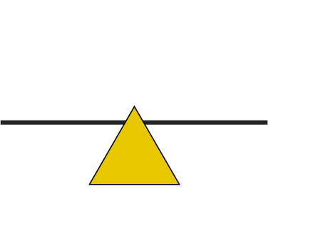

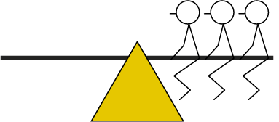
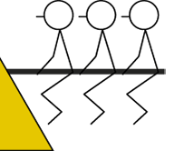
6 ÷ 2
= 3
6 divided between 2 is equal to 3.
Half of 6 is 3.

Slide 17
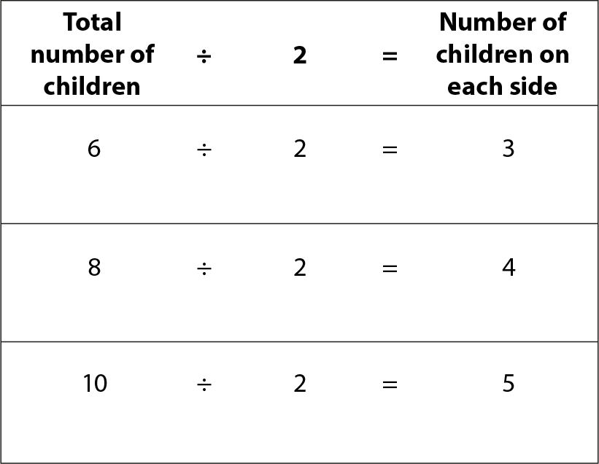


What do you notice?

Slide 18
To be able to divide by 2
Talking Time:
Ruth and Jamal have a total of 10 cookies. They share them equally.
How many cookies does each person receive?
In total, there are __ cookies.
They have been shared by __ people.
Each person receives a total of __ cookies.
10
÷
=

Slide 19
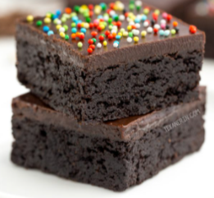
To be able to divide by 2
Task 2:
Ahmed and James have a total of 12 brownies. They share them equally.
How many brownies does each person receive? Draw a bar model:
In total, there are __ brownies.
They have been shared by __ people.
Each person receives a total of __ brownies.
÷
=

Slide 20
To be able to divide by 2
Task 2:
Ahmed and James have a total of 16 brownies. James eats half of the brownies. How many does he eat? Draw a bar model:
In total, there are __ brownies.
They have been shared by __ people.
Each person receives a total of __ brownies.
÷
=

Slide 21

To be able to divide by 2
Task 3:
Ruth has 14 pairs of cubes.
Jamal makes 10 groups with 2 cubes in each group.
How many cubes does each person have?
Who has the most cubes? By how many?

Slide 22
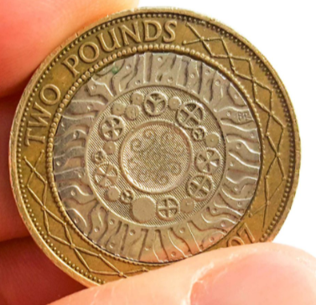
To be able to divide by 2
Challenge:
I have £22 and give it away equally to my two favourite charities.
How much money does each charity receive?
I have £22 all in £2 coins.
How many £2 coins do I have altogether?
Which of these is grouping and which is sharing? Explain your answer.

Slide 23
To be able to divide by 2
Evaluation:
Is Astrobee’s statement always sometimes or never true?
Explain your answer.
You can divide even numbers by 2.

