Slide 1

08.02.21
LO: To be able to divide using grouping.
Steps to Success:
I can put objects into equal groups
I can write a division number sentence.
I can begin to explain and suggest reasons for my results.

Slide 2
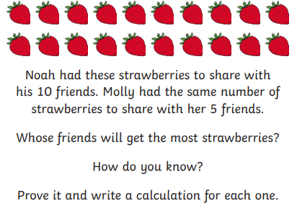
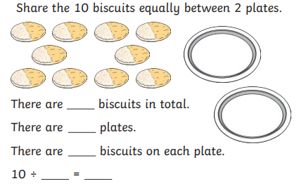
Revision: Solve a problem using sharing 08.02.21

Slide 3
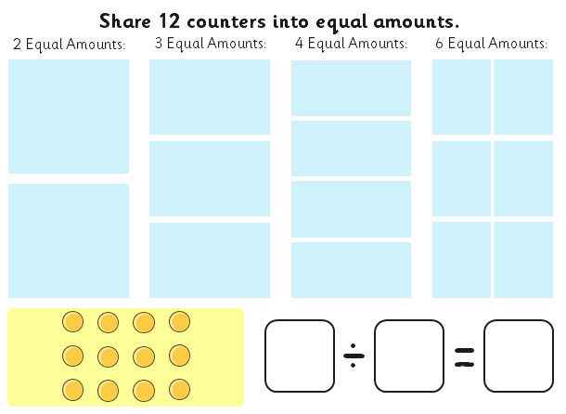
08.02.21

Slide 4



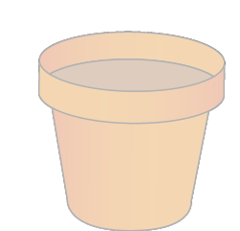

2.6 Quotitive and partitive division Step 2:4
14 seeds, 2 in each pot. How many pots?
14 divided into groups of 2.
14 ÷ 2
Notes:
There are fourteen seeds. Two seeds are planted in each pot.
How many pots are needed?
Quotitive (grouping) structure

Slide 5

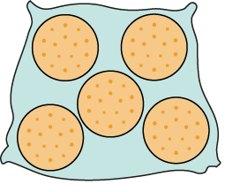
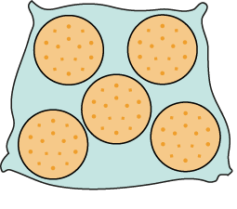

2.6 Quotitive and partitive division Step 2:2
15 biscuits, 5 in a bag. How many bags?
15 is divided into groups of 5.
There are 3 groups.
There are 3 groups of 5 in 15.
Notes:
There are fifteen biscuits. If I put them into bags of five, how many bags will I need?
Quotitive (grouping) structure

Slide 6
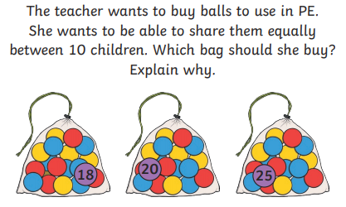
08.02.21

Slide 7
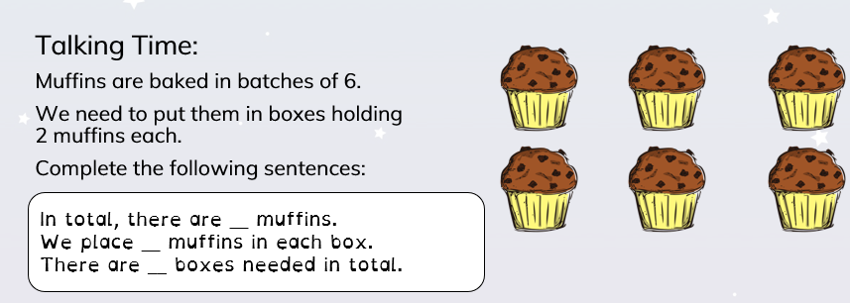
08.02.21

Slide 8


08.02.21

Slide 10


Slide 12
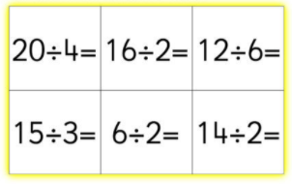
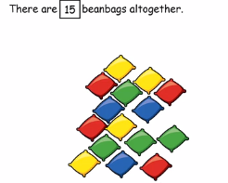
08.02.21
Task 1: Pick 4 division sentences. Make, then draw the groups.
Can you write the inverse (multiplication)?
Task 2: Draw these beanbags, group them in two different ways, then write the number sentences to match.

Slide 13
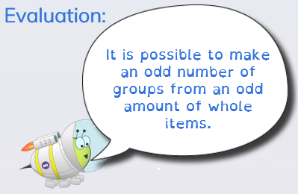

Slide 14
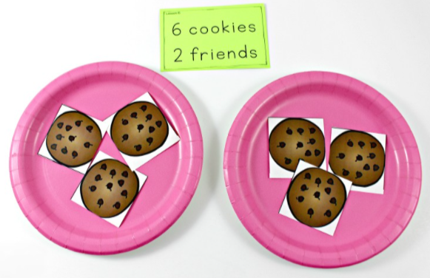
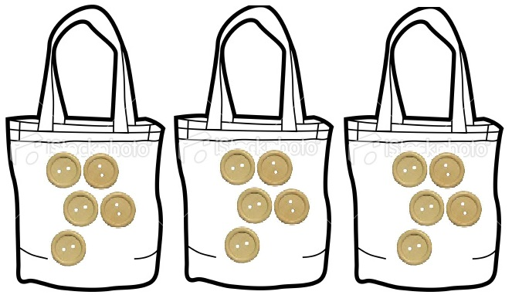

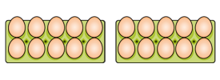
Challenge: Make a poster showing equal groups that you might find around you.
Write the number sentences to match.

Slide 15
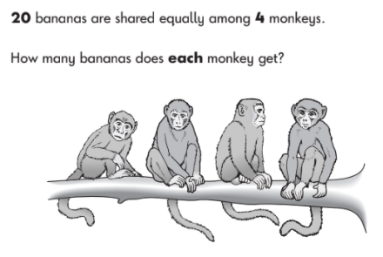
Plenary 08.02.21

Slide 16
09.02.21
LO: To be able to divide using grouping (with some remainders).
Steps to Success:
I can put objects into equal groups
I can write a division number sentence.
I can work out how many will be leftover when dividing into groups

Slide 17
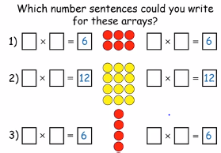
09.02.21

Slide 18

09.02.21
16 children, how many pairs?
We can represent this as 16 divided into groups of .
2
16 ÷ 2
Notes:
There are sixteen children. The children get into pairs.
How many pairs will there be?
Quotitive (grouping) structure

Slide 19
2.6 Quotitive and partitive division Step 2:6
15 biscuits in bags of 5. How many bags?
2 bags of 5 is 10.
3 bags of 5 is 15.
1 bag of 5 is 5.
15 ÷ 5
= 3
15 is divided into groups of 5. There are 3 groups.
15 divided into groups of 5 is equal to 3.
Notes:
There are fifteen biscuits.
If I put them into bags of five, how many bags will I need?
Quotitive (grouping) structure

Slide 20

2.6 Quotitive and partitive division Step 2:7
3 fives
+ 5
+ 5
+ 5
0
5
10
15
5 + 5 + 5 = 15
15 ÷ 5 = 3
15 divided into groups of 5 is equal to 3.
Notes:
Quotitive (grouping) structure

Slide 21













2.6 Quotitive and partitive division Step 2:8
8 balloons, 2 to each child. How many get balloons?
3 twos are 6.
2 twos are 4.
4 twos are 8.
1 two is 2.
Notes:
I have eight balloons. I give two balloons to each child.
How many children get balloons?
Quotitive (grouping) structure

Slide 22






2.6 Quotitive and partitive division Step 2:8
2 + 2 + 2 + 2 = 8
4 twos
+ 2
+ 2
+ 2
+ 2
Notes:
Quotitive (grouping) structure

Slide 23



2.6 Quotitive and partitive division Step 2:9
30 cm ribbon. How many 5 cm lengths can be made?
30 ÷ 5
= 6
6 fives
+ 5
+ 5
+ 5
+ 5
+ 5
+ 5
5 + 5 + 5 + 5 + 5 + 5 = 30
Notes:
A dressmaker has a ribbon that is thirty centimetres long. She needs five-centimetre lengths.
How many five-centimetre lengths can she make?
Quotitive (grouping) structure

Slide 24
2.6 Quotitive and partitive division Step 2:9
30 | ÷ | 5 | = | 6
dividend | ÷ | divisor | = | quotient

Slide 25
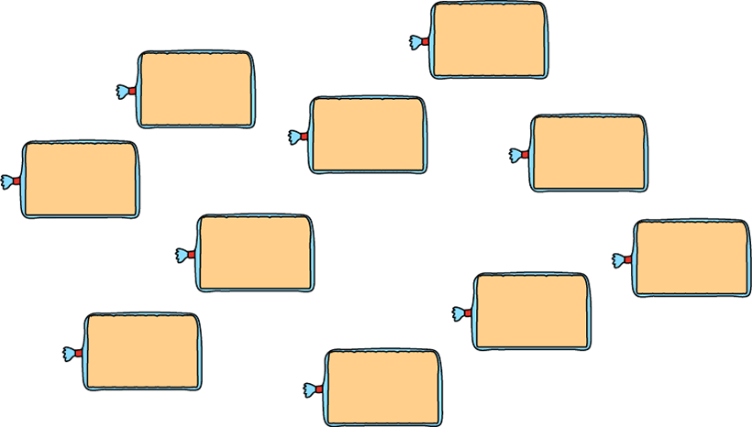





2.6 Quotitive and partitive division Step 2:11
10 loaves, 5 in each bag. How many bags?
= 2
10 ÷ 5
10 divided into groups of 5 is equal to 2.
Notes:
I go into a bakery to buy ten loaves of bread.
I can fit five loaves of bread into each bag. How many bags will I need?
Quotitive (grouping) structure

Slide 26

2.6 Quotitive and partitive division Step 4:6
3 × 2 = 6
2 × 3 = 6
6 ÷ 2 = 3

Slide 27
09.02.21
Count out 9 objects. Can you put them into groups of twos? What do you notice?
9 = 2 + 2 + 2 + 2 + 1
9 2 = 4 + 1
Notes:
Nine is divided into four groups of two with a remainder of one.

Slide 28

2.6 Quotitive and partitive division Step 1:4
15 2 =

Slide 29



09.02.21
Task 1: Complete the drawing to match the equation.
13
2 =6
+ 1
Notes:
Iniko started drawing some mittens.
Complete his drawing to match the equation.

Slide 30
09.02.21
Task 1: Sort the numbers into the correct groups.
Draw/make some groups of 2s to show your workings.
4
62
2
7
100
5
31
34
48
99
43
Can be divided by 2 | Can’t be divided by 2
What did you notice? Which numbers would have a remainder? Why?

Slide 31
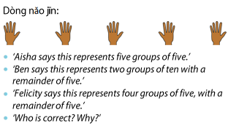
Challenge 09.02.21

Slide 32


Plenary 09.02.21
5 biscuits into bags of 5. How many bags?
5 ÷ 5 =
1
Notes:
I am putting biscuits into bags of five. I have five biscuits.
How many bags of five can I make?
Quotitive (grouping) structure

Slide 33
2.6 Quotitive and partitive division Step 5:4
5 biscuits into bags of 1. How many bags?
5 ÷ 1 =
5
…
…
…
…
Notes:
I am putting biscuits into bags of one.
I have five biscuits. How many bags of one can I make?
Quotitive (grouping) structure

