Slide 1
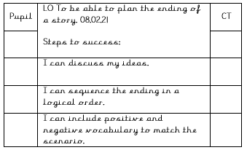
Lesson 1

Slide 2
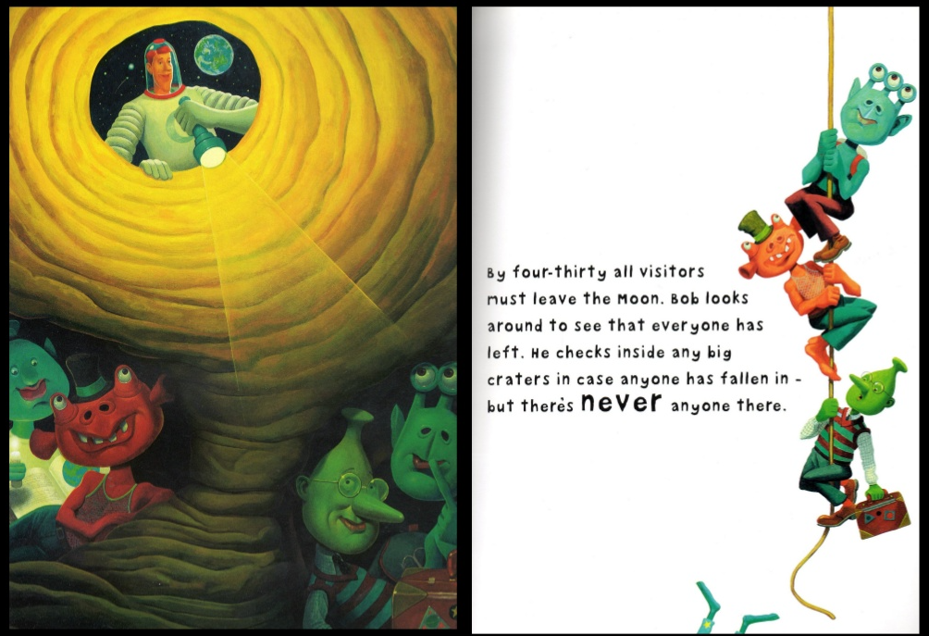
Lesson 1
L.O. To be able to plan the ending of a story.

Slide 3
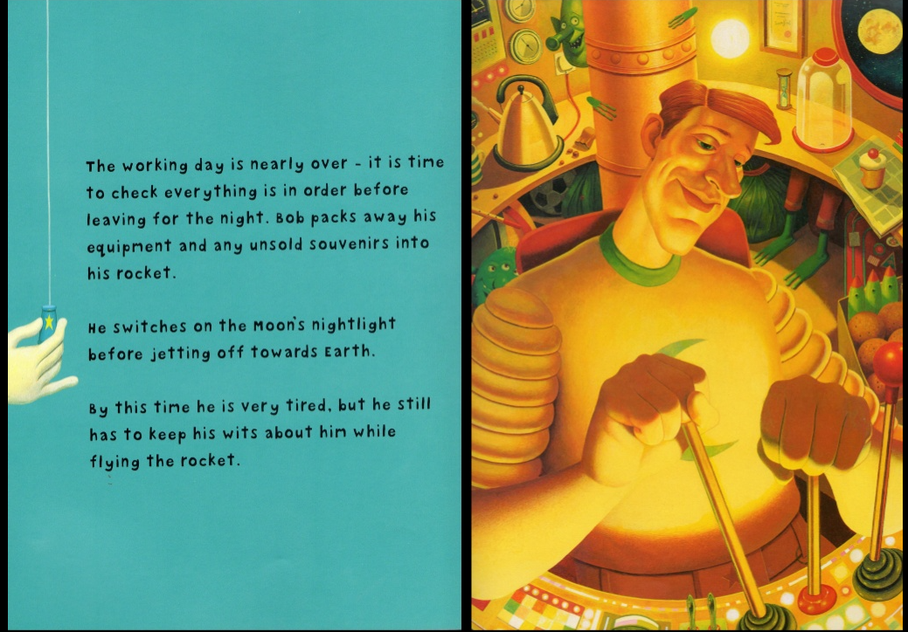
Lesson 1
L.O. To be able to plan the ending of a story.

Slide 4
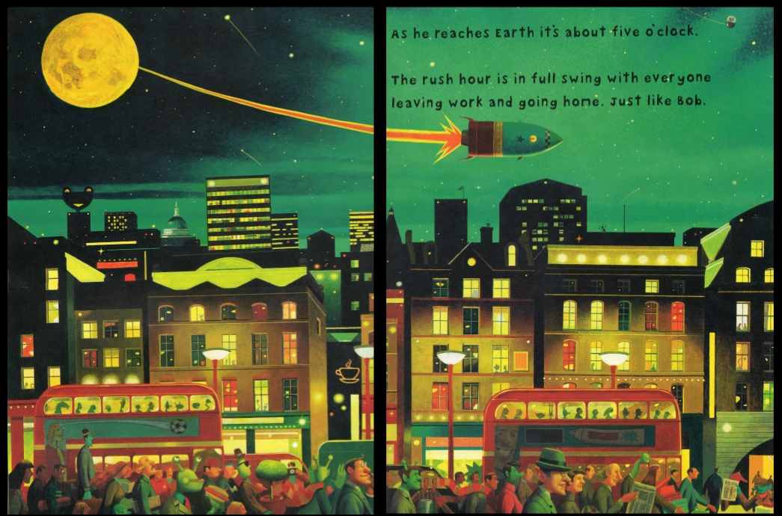
Lesson 1
L.O. To be able to plan the ending of a story.

Slide 5
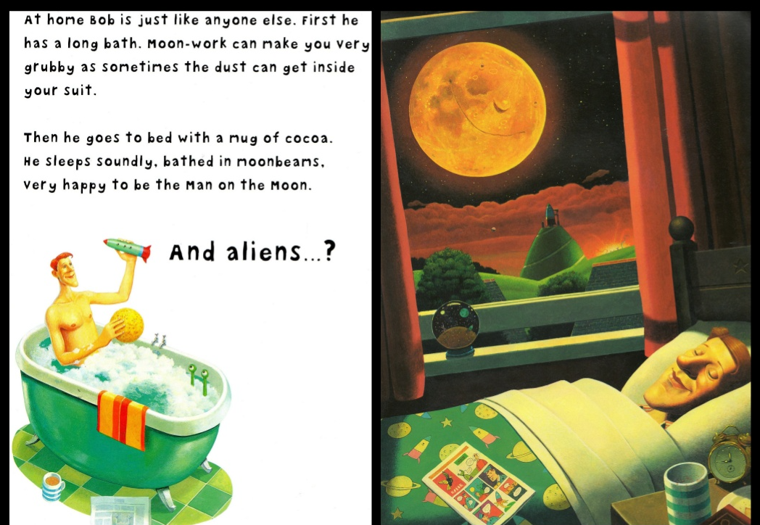
Lesson 1
L.O. To be able to plan the ending of a story.

Slide 6
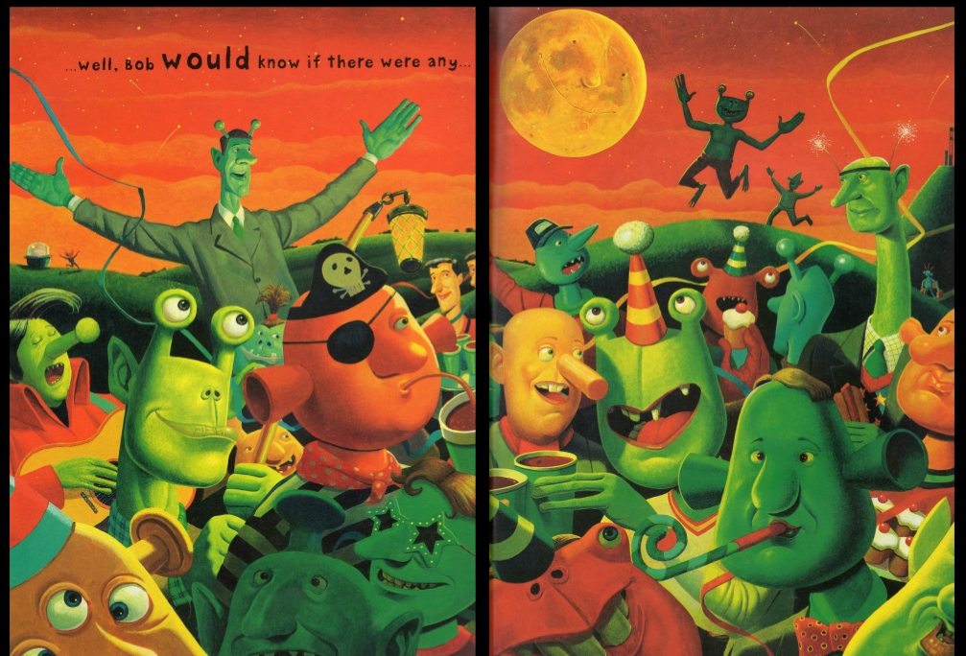
Lesson 1
L.O. To be able to plan the ending of a story.

Slide 7
Lesson 1
L.O. To be able to plan the ending of a story.
1. How is Bob feeling after a long day at work?
2. What could Bob find in the craters?
3. What would Bob’s reaction be? How would he feel?
4. Where could your alien take Bob?

Slide 8
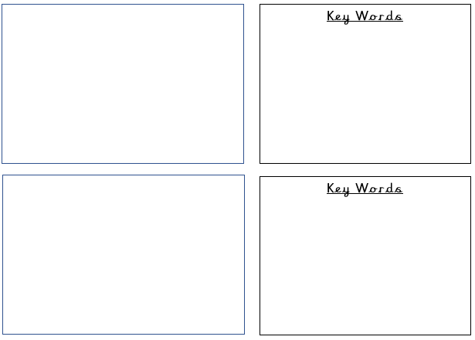
Lesson 1
L.O. To be able to plan the ending of a story.

Slide 9
Lesson 1
L.O. To be able to plan the ending of a story.
Key Words
exhausted shattered proud
grateful aliens surprised
astonished shocked anxious
terrified adventure calm apprehensive
spaceship excited cautious nervous

Slide 10
Lesson 1
L.O. To be able to plan the ending of a story.
Oh no! Something negative has happened! What could it be?

Slide 11
Lesson 1
L.O. To be able to plan the ending of a story.
How could we turn the negative into a positive outcome?

Slide 12
Lesson 1
L.O. To be able to plan the ending of a story.

Slide 13
Lesson 1
L.O. To be able to plan the ending of a story.
Key Words
terrified lost saved entertained
relieved glad trapped panic
famous dancing delighted followed
noise powerful happening “Oh no!”
“What do we do?” disappeared spacecraft

Slide 14
Lesson 1
L.O. To be able to plan the ending of a story.
Challenge: What adverbs could use for your story?

Slide 15
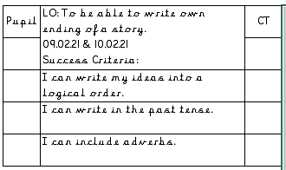
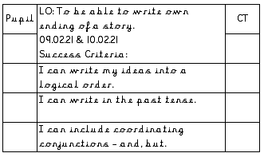
Lesson 2

Slide 16
Lesson 2
L.O. To be able to write the ending of a story.
bravely cautiously courageously
tiredly wearily
________________________________________________________________________________________________________________________________________________________________________________________________________________________________________________________________________________________________

Slide 17
Lesson 2
L.O. To be able to write the ending of a story.
________________________________________________________________________________________________________________________________________________________________________________________________________________________________________________
________________________________________________________________________________________________________________________________________________________________________________________________________________________________________________________________________________________________

Slide 18



Lesson 2
L.O. To be able to write the ending of a story.
CHALLENGE:
Without warning, Bob could see…
All Bob could hear was…
Suddenly, Bob jumped up…

Slide 19
Lesson 2
L.O. To be able to write the ending of a story.
All of a sudden, Suddenly,
Immediately, Out of the blue,
Without hesitation,
________________________________________________________________________________________________________________________________________________________________________________________________________________________________________________________________________________________________

Slide 20
Lesson 2
L.O. To be able to write the ending of a story.
________________________________________________________________________________________________________________________________________________________________________________________________________________________________________________
________________________________________________________________________________________________________________________________________________________________________________________________________________________________________________________________________________________________

Slide 21


Lesson 2
L.O. To be able to write the ending of a story.
CHALLENGE:
All of a sudden, They were going…
Before Bob had realised…
Bob thought to himself, Suddenly,
Bob ________ into the…

Slide 22
Lesson 3

Slide 23
Lesson 3
L.O. To be able to write the ending of a story.
zoomed lingered dashed glided
________________________________________________________________________________________________________________________________________________________________________________________________________________________________________________________________________________________________

Slide 24
Lesson 3
L.O. To be able to write the ending of a story.
________________________________________________________________________________________________________________________________________________________________________________________________________________________________________________
________________________________________________________________________________________________________________________________________________________________________________________________________________________________________________________________________________________________

Slide 25

Lesson 3
L.O. To be able to write the ending of a story.
The spaceship zoomed through the sky whilst dodging the comets like a speedboat, riding the waves.
CHALLENGE:
They were… As they were flying…
The spaceship… In that moment…
They were being…

Slide 26
Lesson 3
L.O. To be able to write the ending of a story.
FEELINGS:
________________________________________________________________________________________________________________________________________________________________________________________________________________________________________________________________________________________________

Slide 27
Lesson 3
L.O. To be able to write the ending of a story.
________________________________________________________________________________________________________________________________________________________________________________________________________________________________________________
________________________________________________________________________________________________________________________________________________________________________________________________________________________________________________________________________________________________

Slide 28

Lesson 3
L.O. To be able to write the ending of a story.
What would be the last thing Bob would say to the alien as he says goodbye?
With a tight throat, Bob said, "…"
CHALLENGE:
Finally, All of a sudden,
Just then, When Bob arrived back,
Bob said to the alien, “…”

