Slide 1
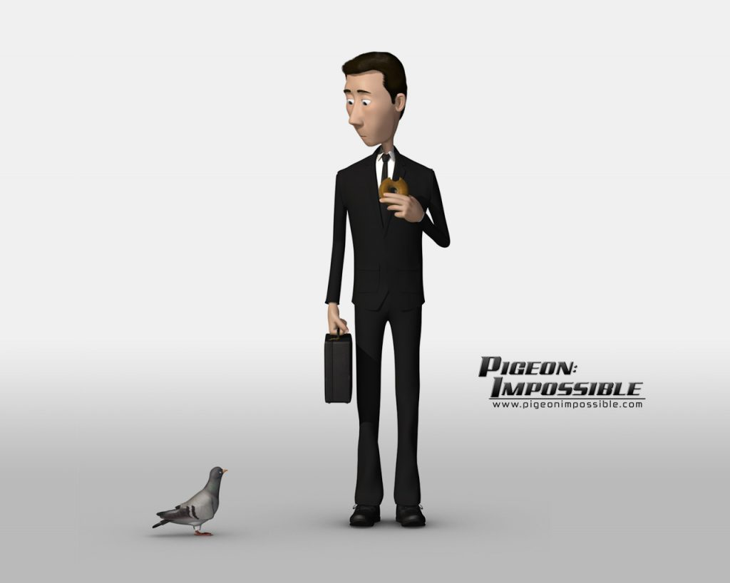

Slide 2
L.O. To be able to write an alternate ending to a story.
What has happened in the story so far?

Slide 3
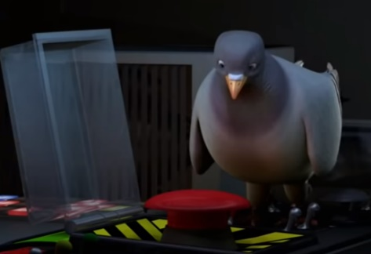
L.O. To be able to write an alternate ending to a story.
Think of 3 things that could happen after this point of the story?
Two things that could disrupt the street.
One thing that happens that solves the problem.

Slide 4

L.O. To be able to write an alternate ending to a story.
Task
Your task is to write an alternative end to the short film, ‘Pigeon: Impossible’. Use the 3 ideas that you have just thought about to write how the story continues and ends.
Walter Beckett pigeon briefcase bagel
button weapons lasers Washington DC
impossible dangerous special agent

