Slide 1
Lesson 1
22.02.21
LO: To begin to understand what a fraction is.
Success Criteria
I can understand what a numerator and a denominator is.
I can find a half of objects.
I can find half of shapes.

Slide 2
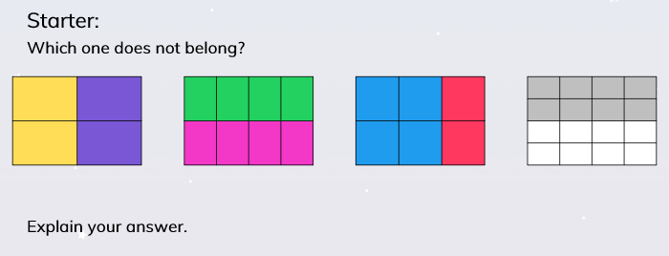
Lesson 1
LO: To begin to understand what a fraction is.

Slide 3

Lesson 1
LO: To begin to understand what a fraction is.

Slide 4
Lesson 1
LO: To begin to understand what a fraction is.

Slide 5

Lesson 1
LO: To begin to understand what a fraction is.

Slide 6
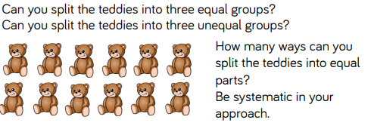
Lesson 1
LO: To begin to understand what a fraction is.

Slide 7
Lesson 1
LO: To begin to understand what a fraction is.
1
2

Slide 8
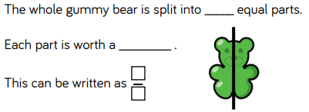
Lesson 1
LO: To begin to understand what a fraction is.

Slide 9
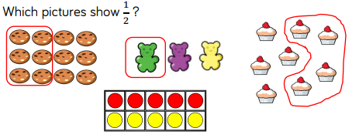
Lesson 1
LO: To begin to understand what a fraction is.

Slide 10
Lesson 1
LO: To begin to understand what a fraction is.
Today's Task
You will need:
- pasta shells
- pairs of shoes
- pairs of socks
- groups of fruit: apples, grapes etc.
- cups and measuring jug
FRACTIONS
½
This is your chance to explore.
Use your resources to find different ways of showing a half.
You can use other resources if you want.
You can record your findings by making a poster about a ½.

Slide 11
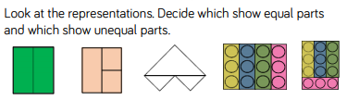
Lesson 1
LO: To begin to understand what a fraction is.

Slide 12
Lesson 2
23.02.20
L.O. To be able to recognise and find a ½ of a set of objects.
Success Criteria:
- I know what a ½ looks like.
- I can find a ½ of a set of objects.
- I can record my findings in a number sentence.

Slide 13
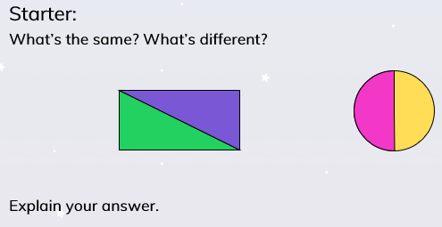
Lesson 2
L.O. To be able to recognise and find a ½ of a set of objects.

Slide 14
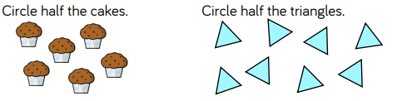

Lesson 2
L.O. To be able to recognise and find a ½ of a set of objects.

Slide 15
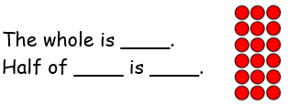
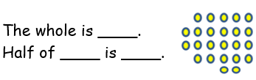
Lesson 2
L.O. To be able to recognise and find a ½ of a set of objects.
Task 1

Slide 16

Lesson 2
L.O. To be able to recognise and find a ½ of a set of objects.

Slide 17
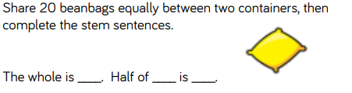
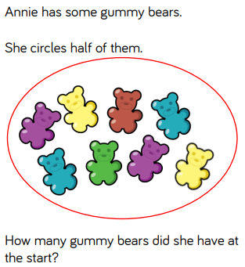
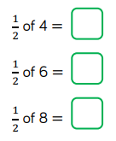
Lesson 2
L.O. To be able to recognise and find a ½ of a set of objects.
Task 2:
Challenge:

Slide 18
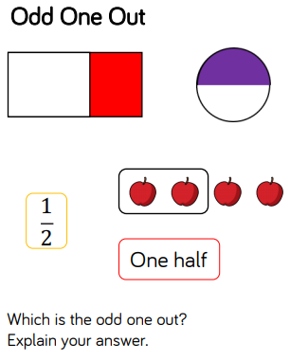
Lesson 2
L.O. To be able to recognise and find a ½ of a set of objects.
Plenary

Slide 19
Lesson 3
24.02.21
L.O. To recognise and find fractions of shapes.
Success Criteria:
I can identify half of a shape.
I can shade half of a shape.
I can write the fraction.

Slide 20
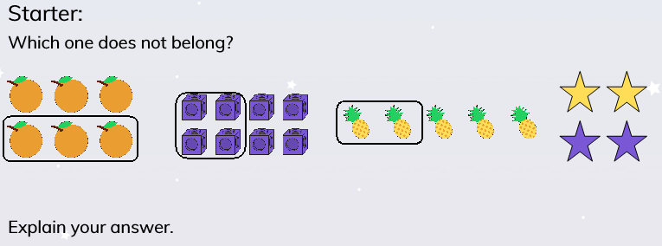
Lesson 3
L.O. To recognise and find fractions of shapes.

Slide 21
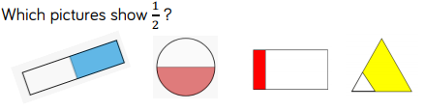
Lesson 3
L.O. To recognise and find fractions of shapes.

Slide 22

Lesson 3
LO To be able to recognise and find different fractions of shapes.
How many ways can I show ½?

Slide 23

Lesson 3
LO To be able to recognise and find different fractions of shapes.
Task 1:
How many ways can you show ½?

Slide 24
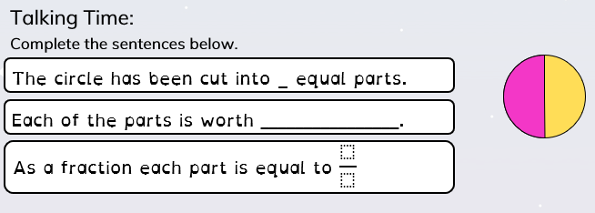
Lesson 3
LO To be able to recognise and find different fractions of shapes.

Slide 25
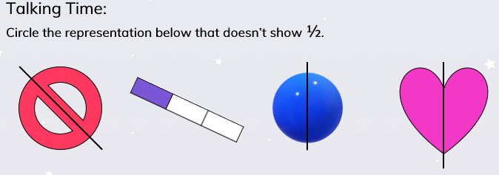
Lesson 3
LO To be able to recognise and find different fractions of shapes.

Slide 26
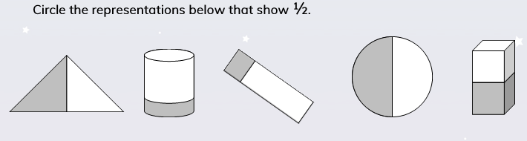
Lesson 3
LO To be able to recognise and find different fractions of shapes.
Task 2:

Slide 27
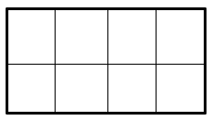
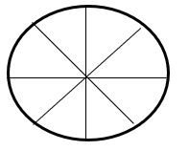
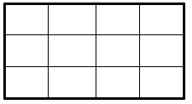
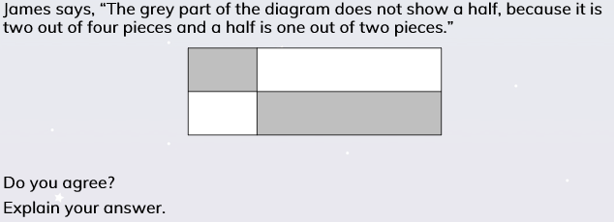
Lesson 3
LO To be able to recognise and find different fractions of shapes.
Task 3:
Challenge:

Slide 28
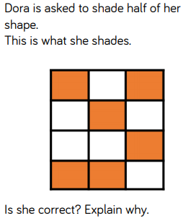
Lesson 3
LO To be able to recognise and find different fractions of shapes.
Plenary

Slide 29
Lesson 4
26.02.21
L.O. To be able to find ½ of an amount.
Success Criteria:
I can identify the total amount.
I can use pictorial representations to find a ½.
I can record the fraction in a number sentence.

Slide 30
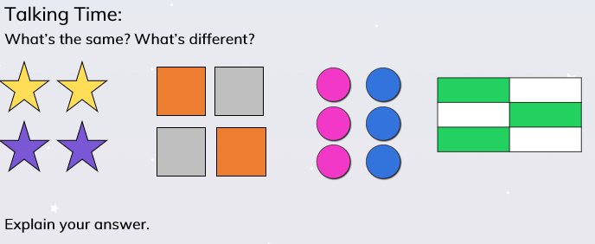
Lesson 4
L.O. To be able to find ½ of an amount.

Slide 31
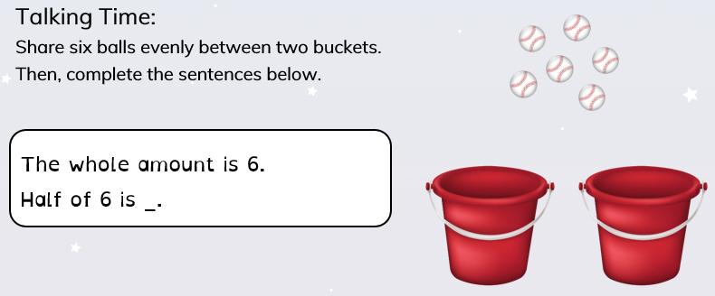
Lesson 4
L.O. To be able to find ½ of an amount.

Slide 32
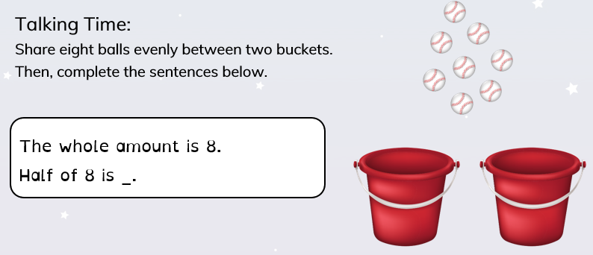
Lesson 4
L.O. To be able to find ½ of an amount.

Slide 33
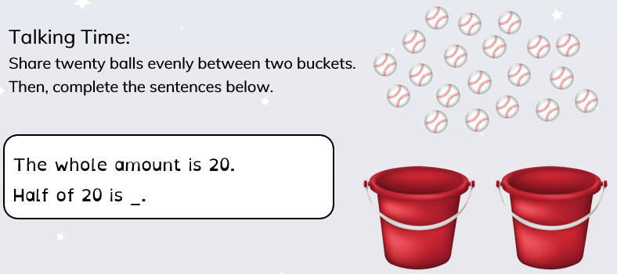
Lesson 4
L.O. To be able to find ½ of an amount.

Slide 34
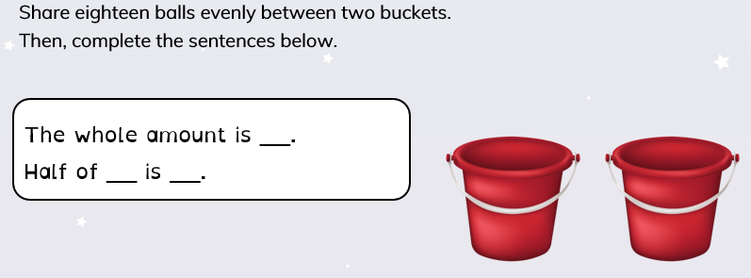
Lesson 4
L.O. To be able to find ½ of an amount.
Task 1:

Slide 35
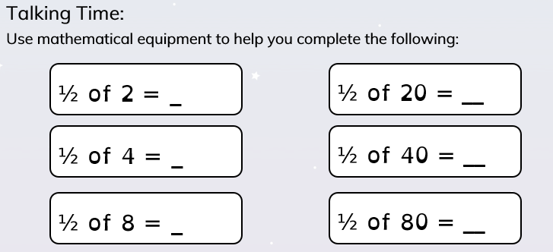
Lesson 4
L.O. To be able to find ½ of an amount.

Slide 36
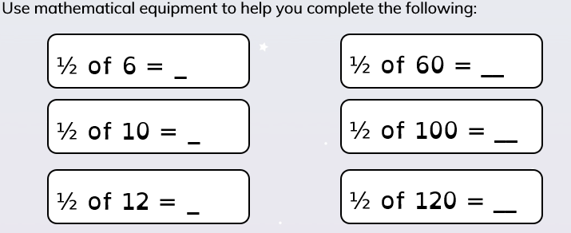

L.O. To be able to find ½ of an amount.
Lesson 4
Task 2:
Challenge 1: Can you think of 2 of your own number sentences?
Challenge 2:

Slide 37
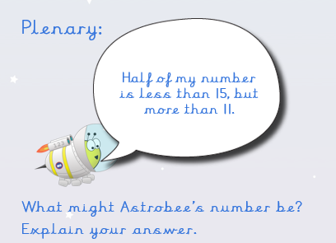
Lesson 4
L.O. To be able to find ½ of an amount.

