Slide 1
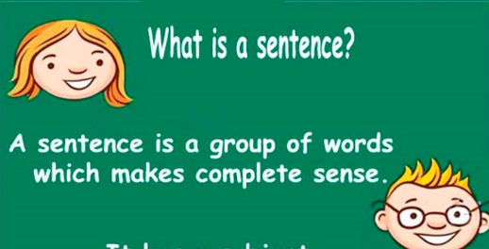
Thursday 25th March English
Please have ready...
Your book and pencil, with the date
Lots of ideas about ....sentences

Slide 2

LO To be an expert in simple sentences
I know what a sentence is.
I can check if a sentence makes sense.
I know a sentence needs a verb.

Slide 3
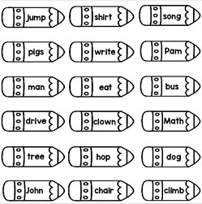
Check 1 – What is a verb?

Slide 4
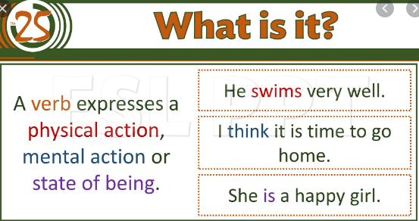

Slide 5


Slide 6
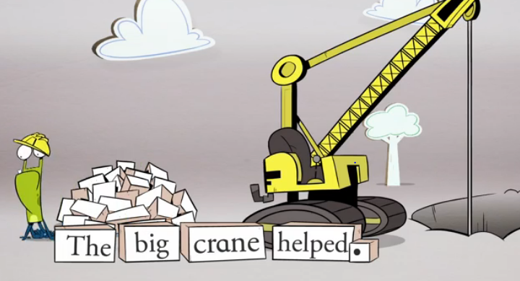
Back to sentences ... https://www.bbc.co.uk/bitesize/articles/zmbmdp3

Slide 7
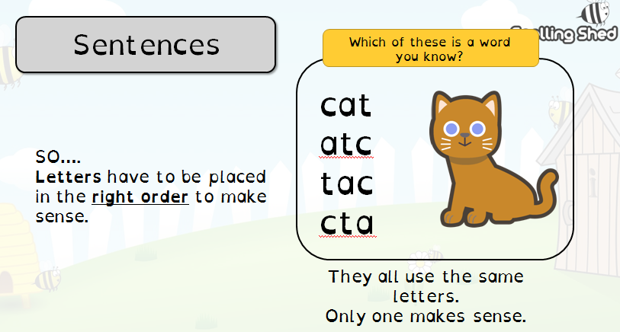
Spelling Shed – 1. Making Meaning

Slide 8
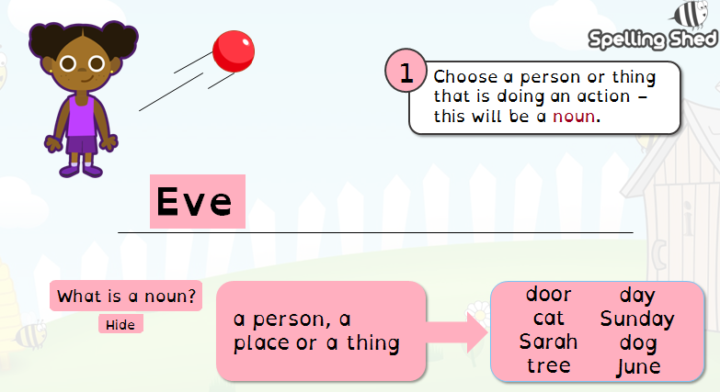
Spelling Shed – 2.Building Sentences

Slide 9
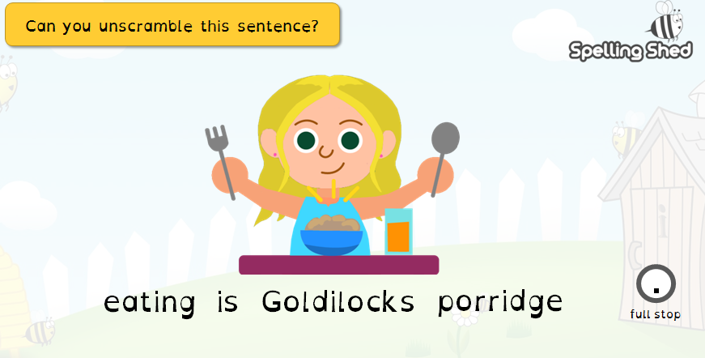
Spelling Shed – 3.Choosing words to make sentences

Slide 10
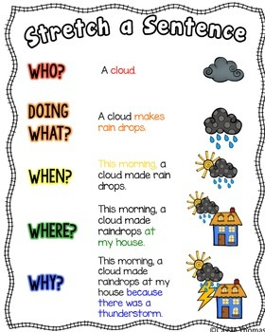
Challenge..
Stretch a sentence !

Slide 11
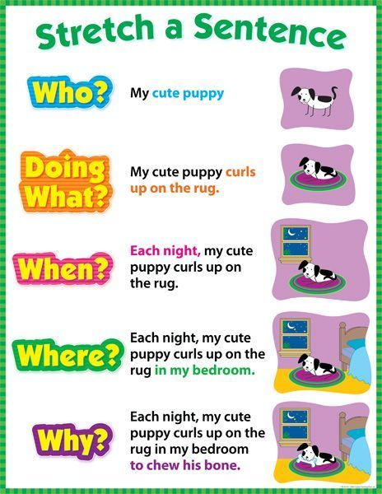

Slide 12
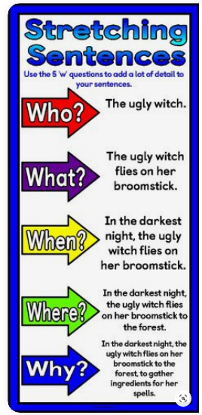

Slide 13
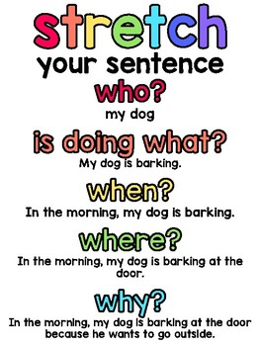

Slide 14
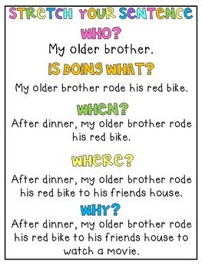

Slide 15
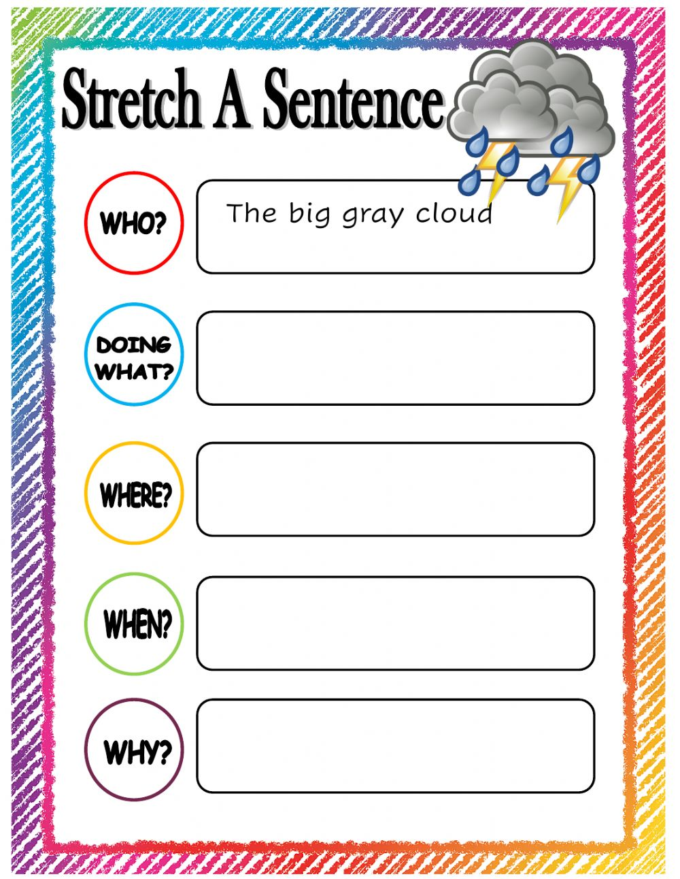

Slide 17
LO To be an expert in simple sentences
I know what a sentence is.
I can check if a sentence makes sense.
I know a sentence needs a verb.

