Slide 1
Choosing words from a bank to create sentences.
Stage 1 Text 1.1
National Curriculum Teaching Point:
Sequencing sentences to form short narratives.
Key vocabulary: sentence, verb, noun, adjective

Slide 2
Quizshed code:

Slide 3
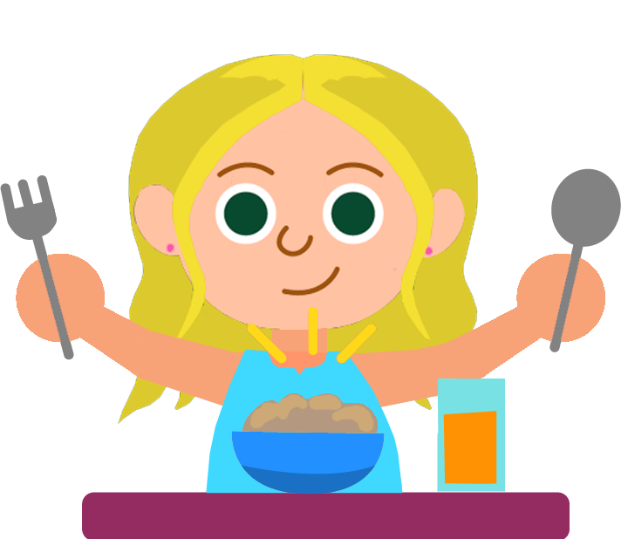
Can you unscramble this sentence?
.
.
eating
is
Goldilocks
porridge
full stop
Check

Slide 4

Can you unscramble this sentence?
.
.
climbed
the
Jack
beanstalk
full stop
Check

Slide 6

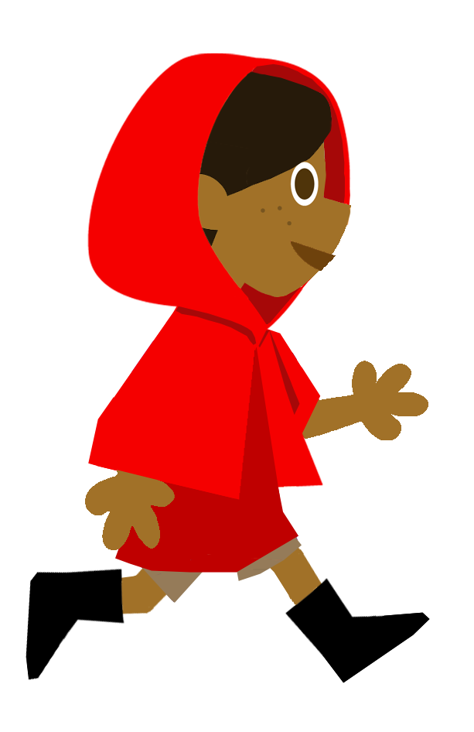
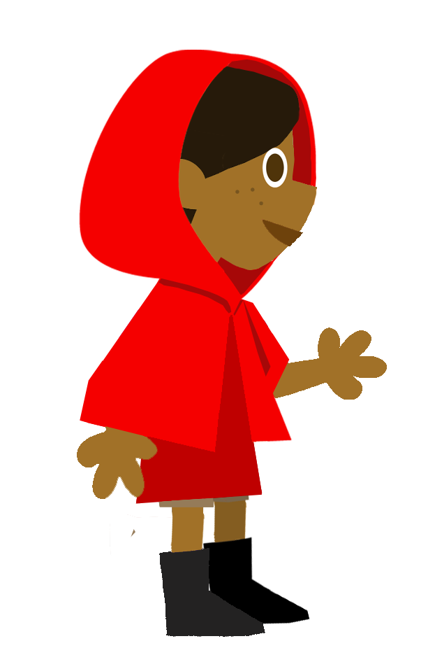
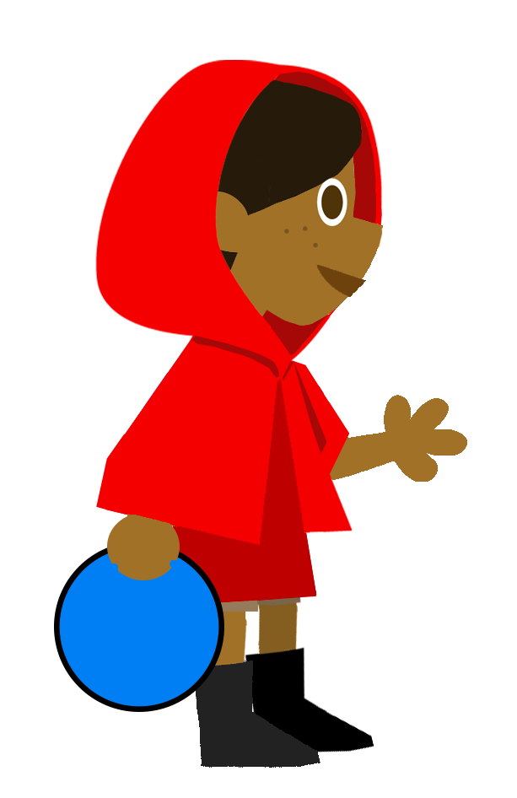
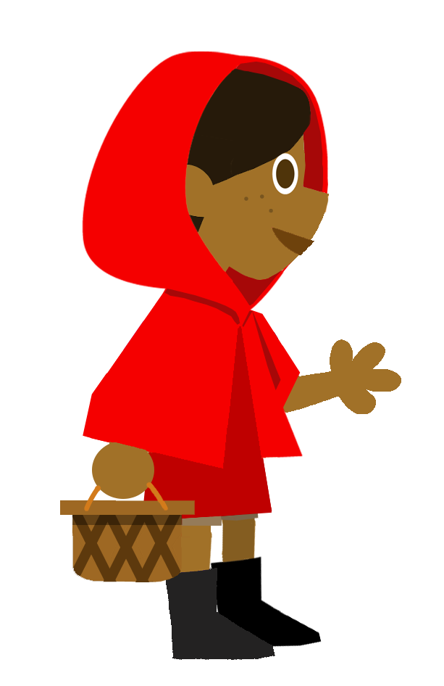
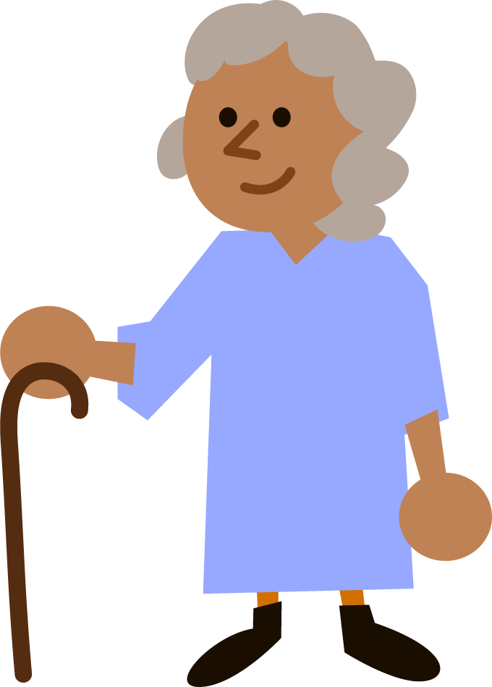


Create a sentence by choosing a word or phrase from each box:
1
2
carried
3
a basket
.
walked
in the woods
.
Red Riding Hood
visited
her grandma
full stop
Reset

Slide 8
Create a sentence by choosing a word or phrase from each box:
1
2
3
opened
the porridge
ate
the door
Goldilocks
.
saw
.
in the small bed
slept
the bear’s house
full stop
Reset

Slide 10
Create a sentence by choosing a word or phrase from each box:
1
2
3
4
tall
5
saw
a
big
beanstalk
Jack
climbed
scary
castle
the
shaky
.
.
full stop
Reset

Slide 11
Join the different parts to create three sentences:
Eve
climbed
in the bed.
Goldilocks
walked
a bean stalk.
Red Riding Hood
slept
the wolf.
Jack
saw
to school.

Slide 12
Can you make a sentence about Jack or Goldilocks from these words?
Goldilocks
Jack
cold porridge
the
the beanstalk
tasted
climbed
.
.
Example

Slide 13
Create your own sentences.
opened
porridge
Goldilocks
ate
door
saw
small bed
Jack
climbed
bear’s house
Red Riding hood
walked
woods

