Slide 1
Building simple sentences.
Stage 1 Sentence 1.3
National Curriculum Teaching Point:
How words can combine to make sentences.
Key vocabulary: noun, verb, sentence, full stop, capital letter

Slide 2



Building sentences
Let’s look at how we can build a sentence.

Slide 3


1
Choose a person or thing that is doing an action – this will be a noun.
Eve
What is a noun?
door
cat
Sarah
tree
day
Sunday
dog
June
a person, a place or a thing
Hide

Slide 4
2
Use a verb to describe what the person is doing.
Eve
throws
What is a verb?
eat
eating
walk
walked
look
looking
play
played
A doing word. It tells us what action someone is doing.
Hide

Slide 5
3
Finally, we may have to write what is being done.
Eve
throws
a ball
.
Don’t forget your full stop:
.
full stop

Slide 6








1
2
3
Choose a noun:
Choose a verb:
Choose another noun:
Birds
Dogs
eat
fish
milk
.
.
Sheep
Cats
drink
water
plants
full stop

Slide 7










1
2
3
Choose a noun:
Choose a verb:
Choose another noun:
James
Jamal
kicks
bread
stones
.
.
.
Ruth
Eve
full stop
eats
cakes
plants

Slide 8



Add words to make these sentences.
Are there any other words that could be used?
Birds
eat seeds.
Don’t forget your full stop.
sleep in caves
Bears
.
swim
Fish in the sea.

Slide 9


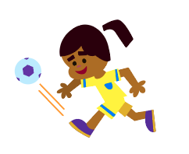
Finish these sentences:
Are there any other words that could be used?
Don’t forget your full stop.
Cats drink
milk
.
Don’t forget your full stop.
Ed
dances
.
to music
Don’t forget your full stop.
plays
.
Simran
football
Simran

Slide 10



Finish these sentences:
Birds
Riding Hood

Slide 11
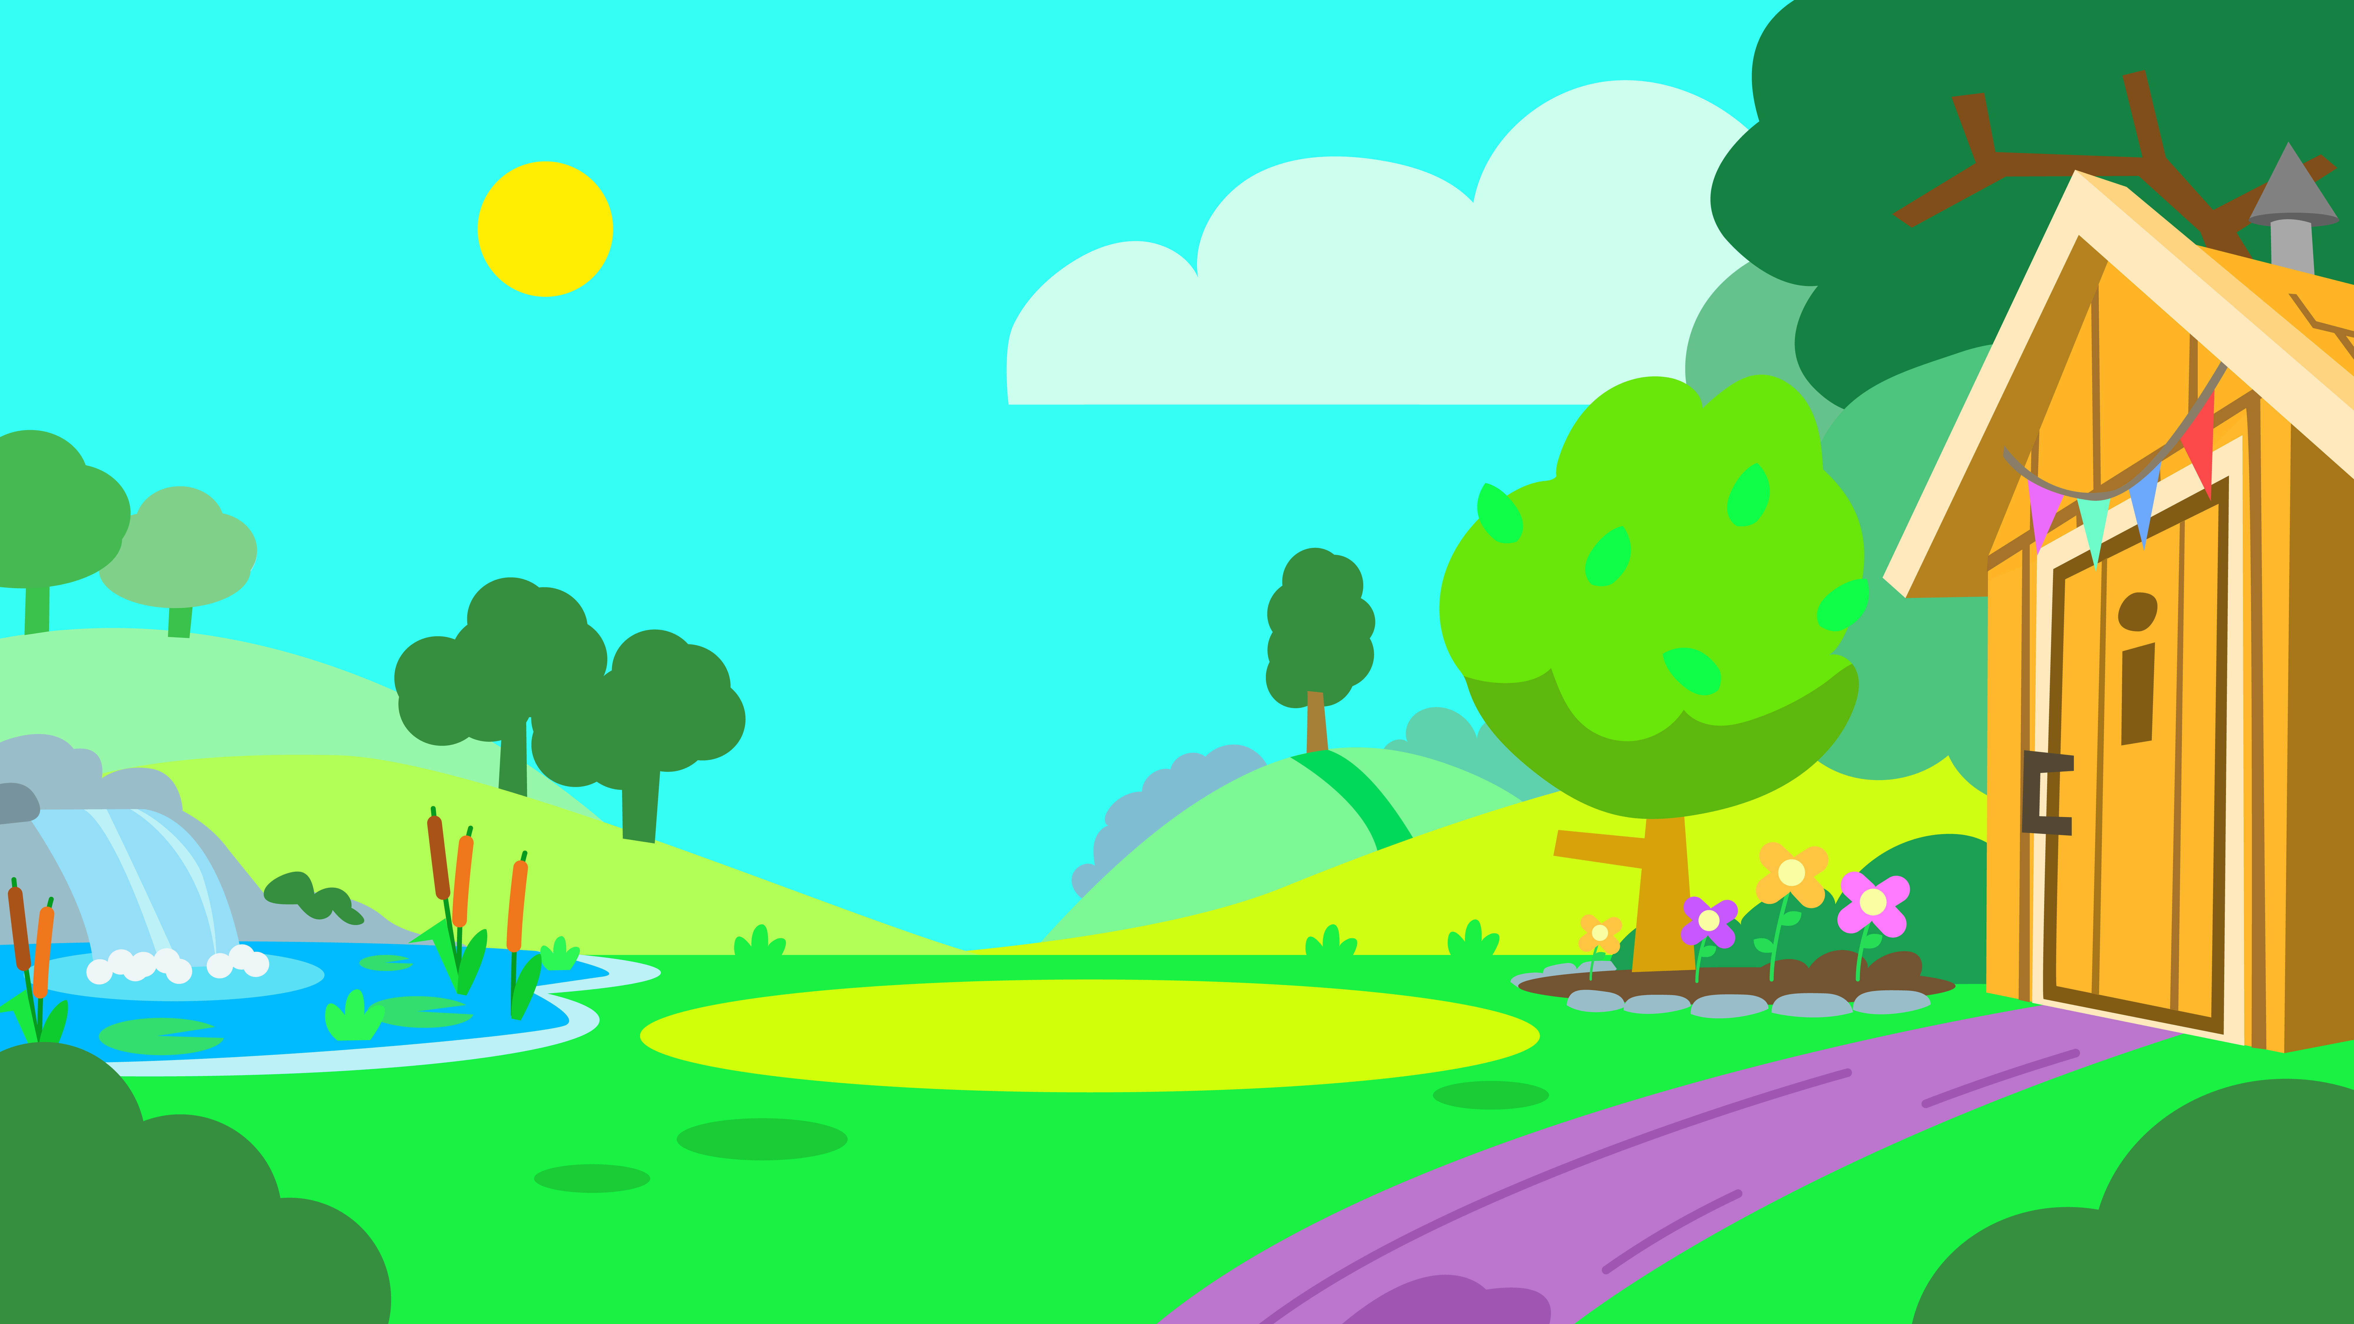



Write your own sentence about this picture:

Slide 12

Write a sentence about your favourite animal, game or thing.

Slide 13
Quizshed code:

