Slide 1
Making meaning in sentences.
Stage 1 Sentence 1.1
National Curriculum Teaching Point:
How words can combine to make sentences.
Key vocabulary: sentence

Slide 2
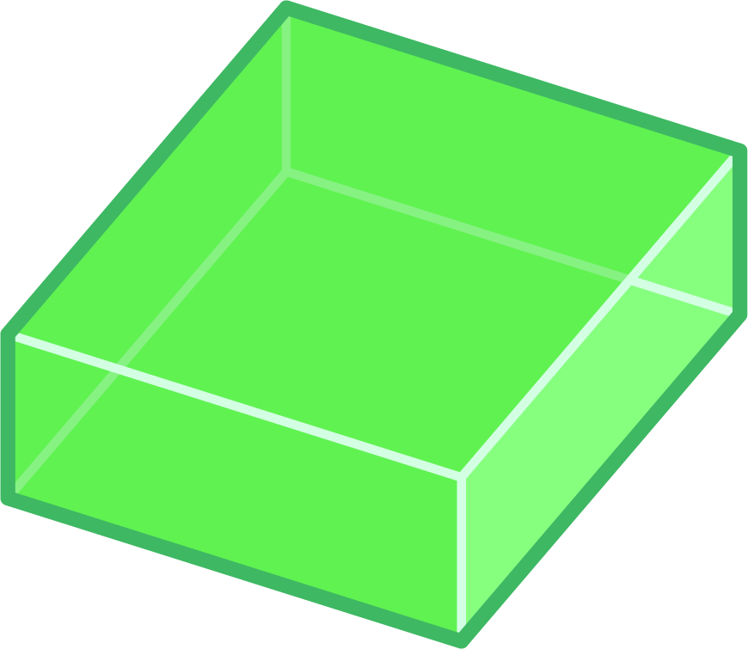



Sentences
c
a
Letters can be joined together to make a word – which has a meaning to all of us.
t
What word can these letters build? Click.
Letters are like building blocks.
They have a clear meaning. Maybe you thought of something like this.

Slide 3

Words, like letters, are building blocks.
Click to build with these words.
cats
tails
have
When we put words together like this, they have a meaning.
It is called a sentence.

Slide 4
Sentences
Which of these is a word you know?
cat
atc
tac
cta
SO….
Letters have to be placed in the right order to make sense.
They all use the same letters.
Only one makes sense.

Slide 5
Sentences
Which groups of words makes sense?
cats have tails
It is the same with sentences!
The words need to be in an order that makes sense.
tails cats have
have tails cats
They all use the same words.
Only one makes sense. Only one is a sentence.

Slide 6

Sentences
Which of Amy’s sentences makes sense?
Amy cheese eats
Amy eats cheese
eats cheese Amy

Slide 7
Sentences
Which of Amy’s sentences makes sense?
I walk to school
to I school walk
school walk I to

Slide 8
Sentences
Which of Amy’s sentences makes sense?
cats mice chase
chase mice cats
cats chase mice

Slide 9

Sentences
1
Has to make sense to the person reading it.
Our first rule of making a sentence is that the words have to be in an order that makes sense.
I walk to school
School I walk to

Slide 10

Sentences
Which of Amy’s sentences makes sense?
1
Eva football kicks
2
Birds have wings
music to James dances
3
Ruth rides a scooter
4

Slide 11
Sentences
Which of Amy’s sentences makes sense?
1
stand in the line
2
I would like an apple
singing song Dan is
3
4
I football like

Slide 12
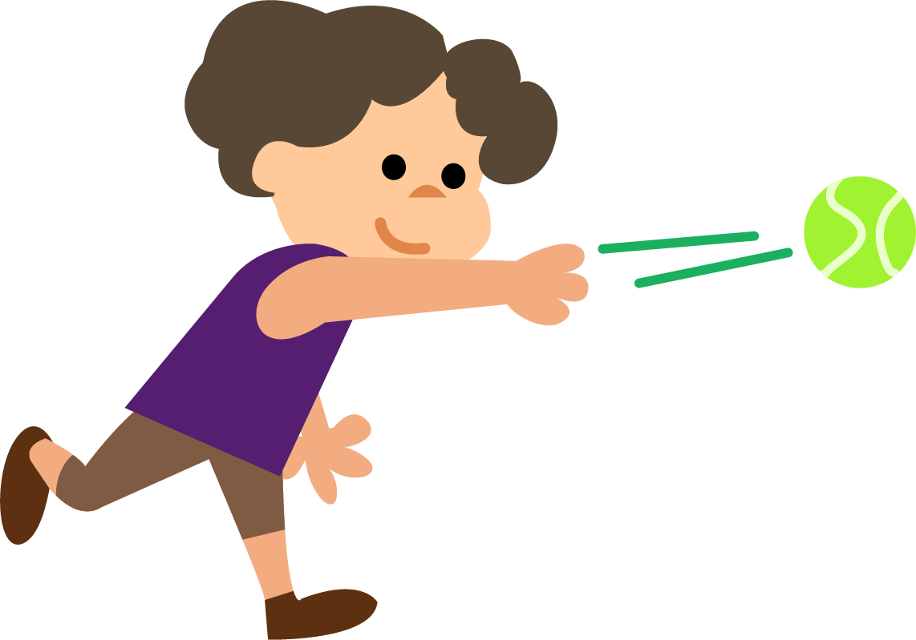
Can you help arrange these words to make a sentence?
Mia
throws
ball
the
check

Slide 13
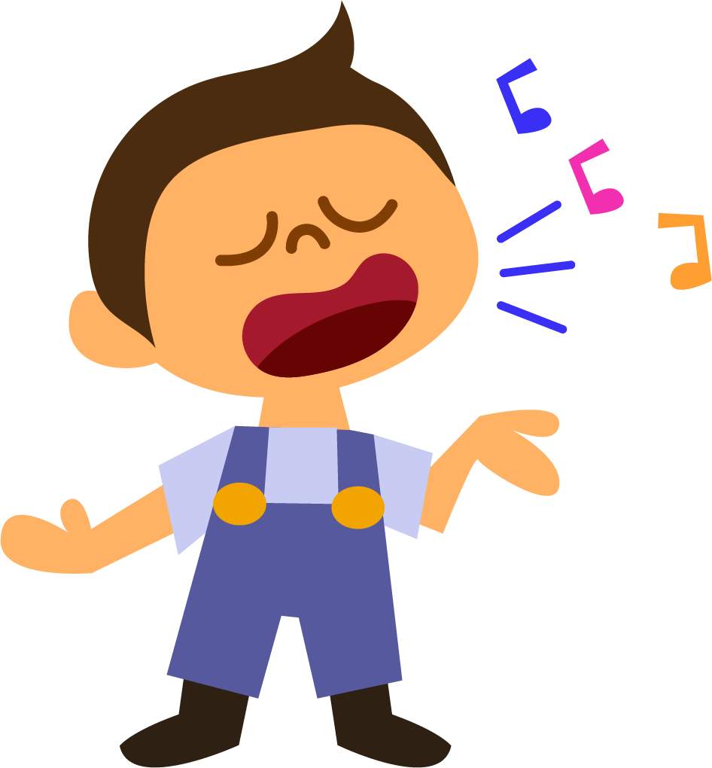
Can you help arrange these words to make a sentence?
Dan
sings
song
a
check

Slide 14
Quizshed code:

