Slide 1
Lesson 1
L.O. To be able to identify a quarter.
Success Criteria:
I can understand what a quarter is.
I can use pictorial representations to represent a whole amount split into quarters.
I can explain my reasoning when identifying a quarter.

Slide 2
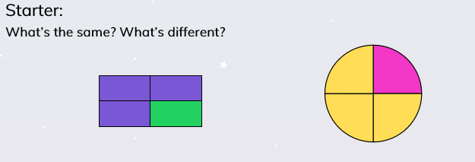
Lesson 1
L.O. To be able to identify a quarter. ​

Slide 3
Lesson 1
L.O. To be able to identify a quarter. ​
1
4

Slide 4
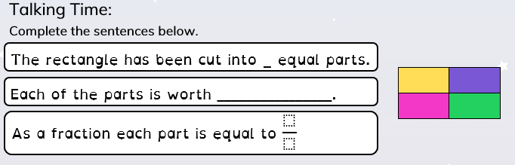
Lesson 1
L.O. To be able to identify a quarter. ​
Task 1

Slide 5
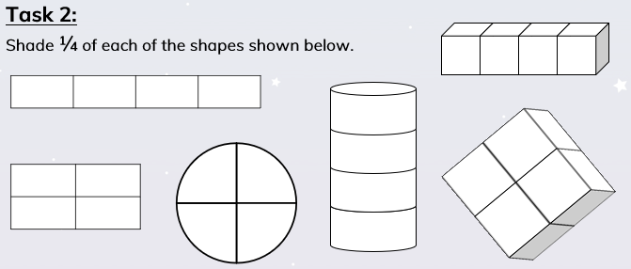
Lesson 1
L.O. To be able to identify a quarter. ​

Slide 6
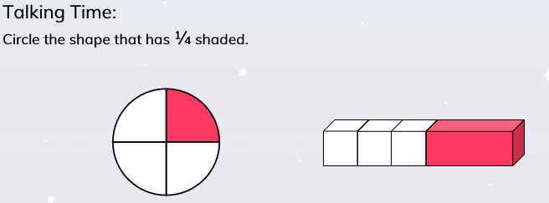
Lesson 1
L.O. To be able to identify a quarter. ​

Slide 7
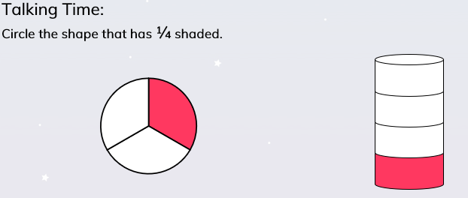
Lesson 1
L.O. To be able to identify a quarter. ​

Slide 8
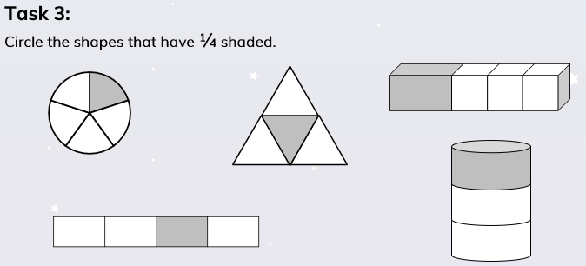
Lesson 1
L.O. To be able to identify a quarter. ​

Slide 9
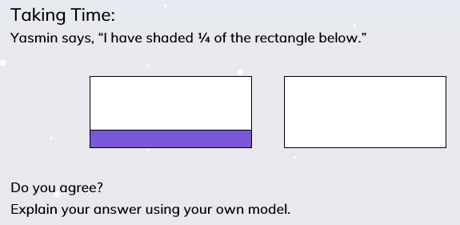
Lesson 1
L.O. To be able to identify a quarter. ​

Slide 10
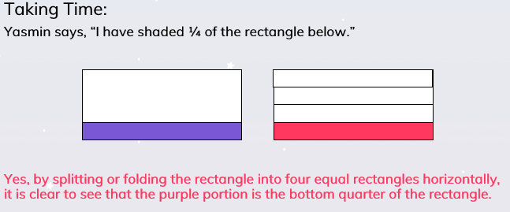
Lesson 1
L.O. To be able to identify a quarter. ​

Slide 11
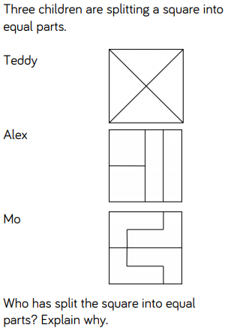
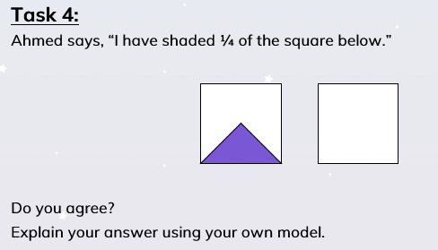
L.O. To be able to identify a quarter. ​
Lesson 1
Challenge:

Slide 12
Lesson 2
L.O. To be able to find a quarter of a given amount.
Success Criteria: ​
I know a quarter needs to be split into 4 equal parts.
I can use mathematical equipment and pictorial representations to find a quarter of a given amount
I can explain my reasoning when finding a quarter of a given amount.

Slide 13
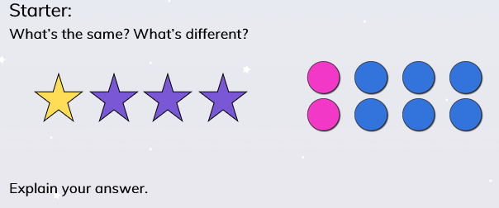
Lesson 2
L.O. To be able to find a quarter of a given amount.

Slide 14
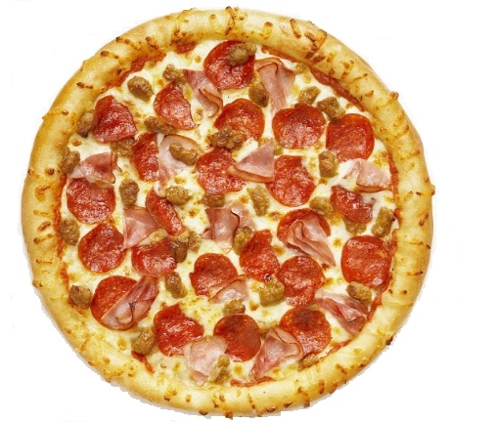
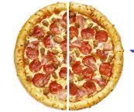
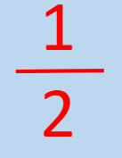

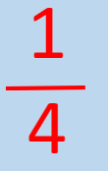
Lesson 2
L.O. To be able to find a quarter of a given amount.
1

Slide 15
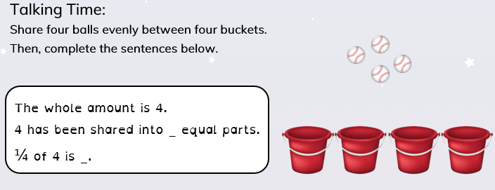
Lesson 2
L.O. To be able to find a quarter of a given amount.

Slide 16
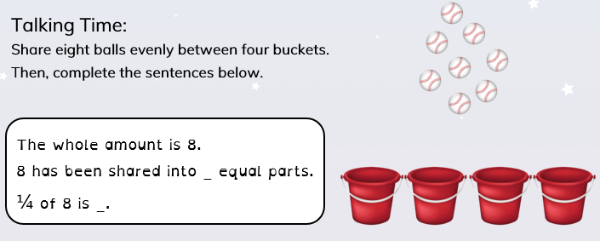
Lesson 2
L.O. To be able to find a quarter of a given amount.

Slide 17
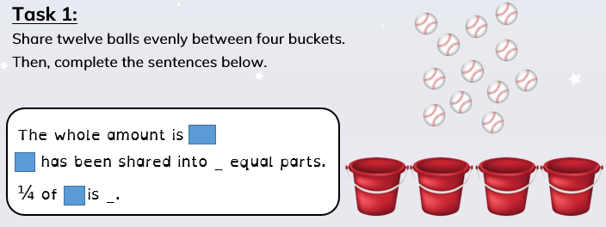
Lesson 2
L.O. To be able to find a quarter of a given amount.

Slide 18
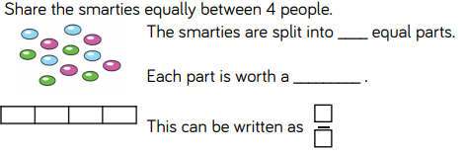
Lesson 2
L.O. To be able to find a quarter of a given amount.

Slide 19
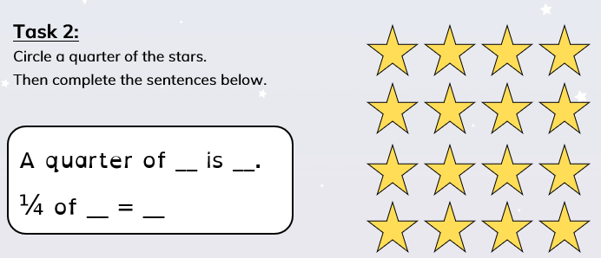
Lesson 2
L.O. To be able to find a quarter of a given amount.

Slide 20
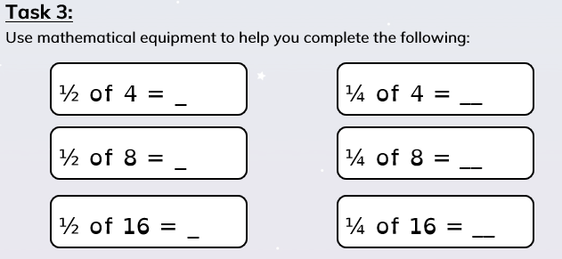
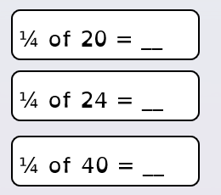

L.O. To be able to find a quarter of a given amount.
Lesson 2
Challenge:

Slide 21
Lesson 3
L.O. To be able to find a quarter of a given amount.
Success Criteria: ​
I know a quarter needs to be split into 4 equal parts.
I can use mathematical equipment and pictorial representations to find a quarter of a given amount
I can explain my reasoning when finding a quarter of a given amount.

Slide 22
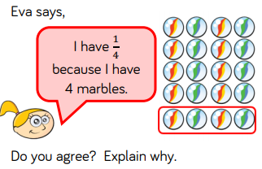
Lesson 3
L.O. To be able to find a quarter of a given amount.
Starter:

Slide 23
Lesson 3
L.O. To be able to find a quarter of a given amount.
1
4

Slide 24
Lesson 3
L.O. To be able to find a quarter of a given amount.

Slide 25
Lesson 3
L.O. To be able to find a quarter of a given amount.
Task 1:
How many ways can you show ¼ with these shapes?

Slide 26
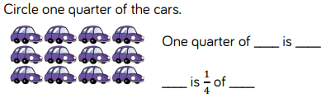
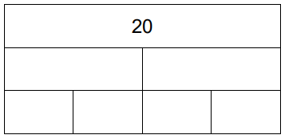
Lesson 3
L.O. To be able to find a quarter of a given amount.

Slide 27
Lesson 3
L.O. To be able to find a quarter of a given amount.
Task 2:

Slide 28
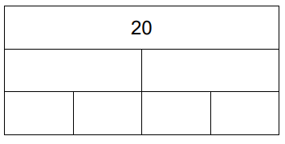
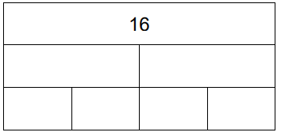
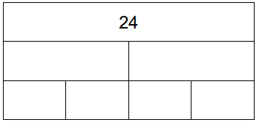
Lesson 3
L.O. To be able to find a quarter of a given amount.
Task 3:
Challenge 1:
36
Challenge 2: Can you find ¾ of these numbers? Make sure you write the number sentence correctly.

Slide 29
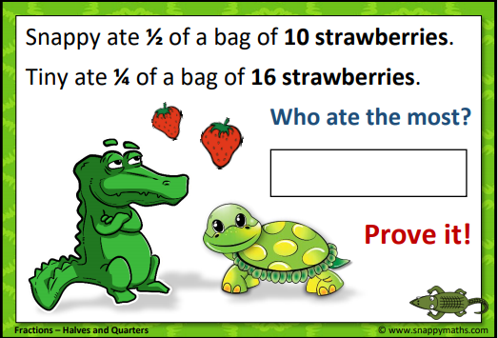
Lesson 3
L.O. To be able to find a quarter of a given amount.

