Slide 1


Slide 2

In the book, Silvio brought a spaceship for the class Show and Tell.
Now it is your turn to design a spaceship of your own.

Slide 3


What does a spaceship need ?
What shape could it be ?
How will it move?
How many people can fit into it ?
Can they see out of the spaceship ?
What colour ? What is it made of ?
Have a talk and start to imagine your spaceship

Slide 4


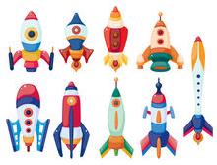
I want to have ... My spaceship will need .....

Slide 5
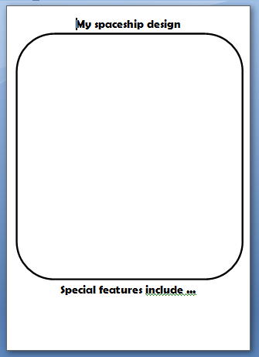
Find this page in your pack and then draw your own amazing spaceship!!!
Add lots of details and colour.
☺
On your sheet, label, and write some of the special features of your spaceship.

Slide 6

Your spaceship needs a little alien to visit it !!
The author of our book – Rob Biddulph – is going to show us how to draw an alien.
We have already met this alien in our book ...His name is Zorg

Slide 7
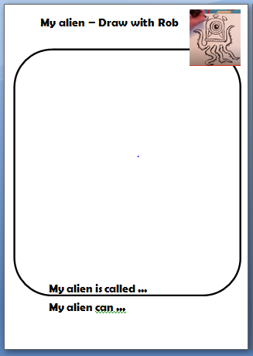
You need ...
*this sheet from your pack
*a black felt pen, or your writing pencil
*coloured pencils

Slide 8
We are going to watch the video now, but you can also watch it on our class page – then you can pause, and start it when you are ready.
For our class zoom this afternoon...
Bring along your finished alien drawing so you can show us how it turned out

