Slide 1


Slide 2
We have already read the book together – you can look at the Power Point for this on our class pages.
You can look carefully at each of the pages to help with this activity.
If you want to listen to the story again, you can also find a video recording of the story on our class page ☺

Slide 3






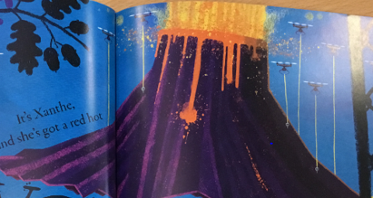
What was your favourite Show and Tell thing from the book?

Slide 4

Find this page in your pack and then draw your favourite thing from the book.
Look back at the book so you can add lots of details.
On the back of your sheet, write some sentences to tell us why it is your favourite

Slide 5
What would YOU bring to school for your Show and Tell ?
Use your imagination to think of the wildest, craziest, funniest, cutest thing...
Let’s talk about a few ideas...

Slide 6

Find this page in your pack and then draw what YOU would bring to school !!!
Add lots of details and colour, so we can see what it is ☺
On the back of your sheet, write some sentences to tell us why you chose this.

Slide 7
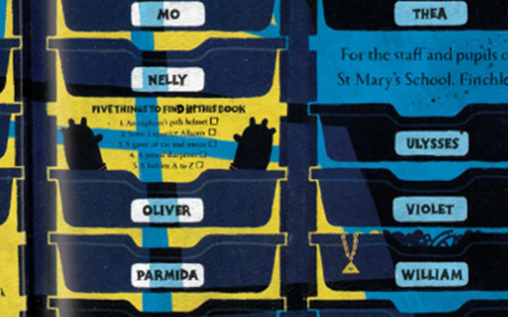
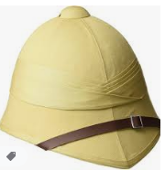


Extra challenge ... Hidden in the book are some extra things for your beady eyes to find...
FIVE THINGS TO FIND ...
An explorer’s pith helmet
Some liquorice Allsorts
A game of cat and mouse
A pencil sharpener
A hidden A to Z

Slide 8

For our class zoom this afternoon...
Can you find something interesting in your house or garden, to bring to Show and Tell ?
Or....
Can you find something small enough to fit into a match box..
For our “Match box Show and Tell” challenge !!

