Slide 1


Slide 2
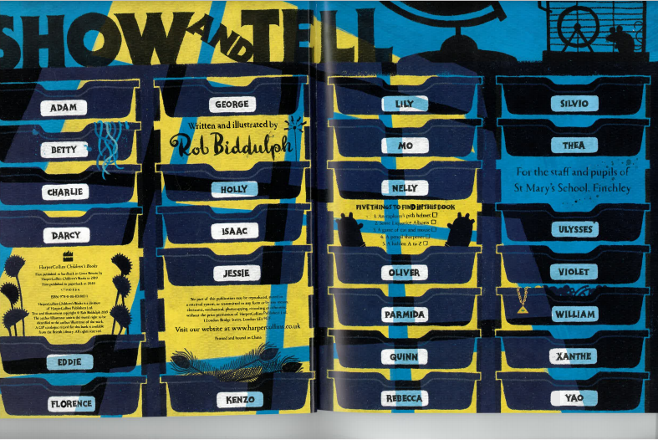

Slide 3


Slide 4


Slide 5


Slide 6


Slide 7


Slide 8


Slide 9


Slide 10


Slide 11
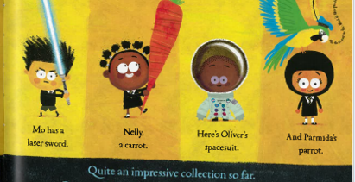

Slide 12


Slide 13


Slide 14


Slide 15


Slide 16


Slide 17
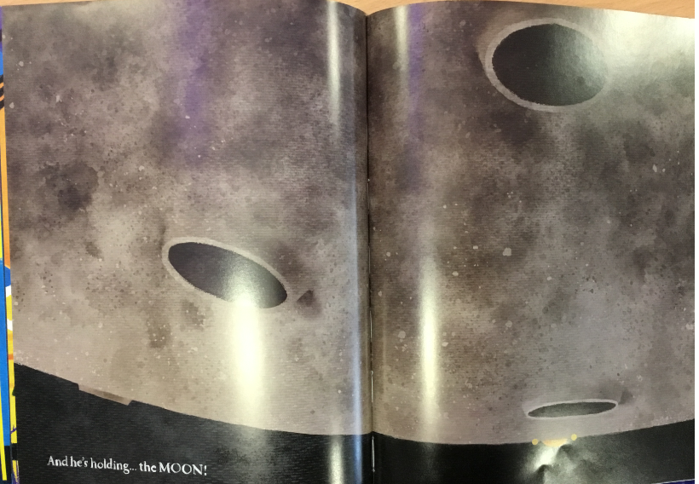

Slide 18


Slide 19
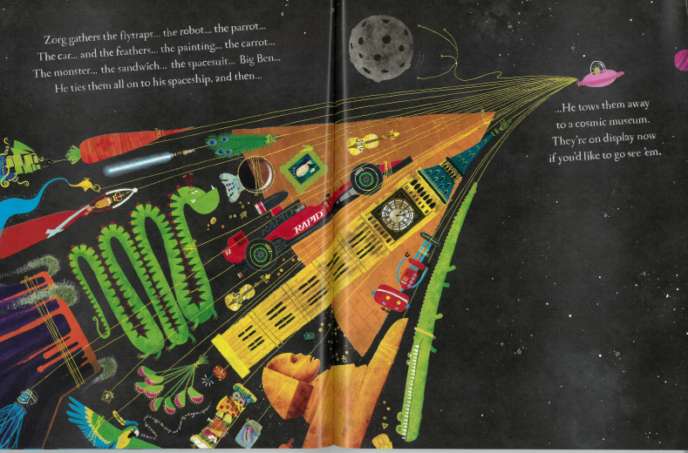

Slide 20


Slide 21


Slide 22

FIVE THINGS TO FIND IN THIS BOOK

