Slide 1
05.03.21
LO: To be able to add and three 1-digit numbers together using number bonds to 10.

Slide 2
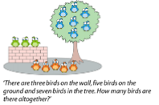
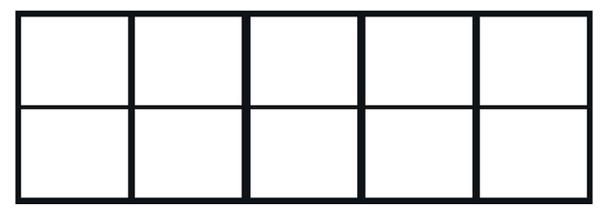
LO: To be able to add and three 1-digit numbers together using number bonds to 10.

Slide 3

LO: To be able to add and three 1-digit numbers together using number bonds to 10.
2
4
8

Slide 4
LO: To be able to add and three 1-digit numbers together using number bonds to 10.
3
7
5

Slide 5
LO: To be able to add and three 1-digit numbers together using number bonds to 10.
5
6
5

Slide 6
LO: To be able to add and three 1-digit numbers together using number bonds to 10.
Task:
6
8
2
1
4
9
6
4
7

Slide 7
LO: To be able to add and three 1-digit numbers together using number bonds to 10.
Challenge:
6
18
2
1
4
19
16
4
7

Slide 8
LO: To be able to add and three 1-digit numbers together using number bonds to 10.
Plenary:
15
-
5
-
7

