Slide 1

Early Reading and Phonics Workshop

Slide 2
What is Phonics?
‘Phonics refers to a method for teaching speakers of English to read and write their language’.
The National Literacy Trust.

Slide 3
Phonics.
We follow the DfES Letters and Sounds phonics programme.
The phonics programme is divided into six phases and each phase builds upon the previous one.

Slide 4
Phase One.
At pre-school, your child has been learning to:
  Have fun with sounds.
  Listen carefully.
  Develop their vocabulary.
  Speak confidently to you, other adults and other children.
  Tune into sounds.
  Listen and remember sounds.
  Talk about sounds.
  Understand that spoken words are made up of different sounds.

Slide 5
Phase Two 1.
Children begin to formally learn the sounds in the English language in Reception.
Phonics sessions are fun sessions involving lots of speaking, lots of listening and lots of games.
Sounds are taught in sets of four across the week.
The aim of phase two is to recognise letters and their sounds and then use them when reading and writing simple cvc (consonant-vowel-consonant) words, e.g. pan, sit, mum and leg.

Slide 6
Phase Two 2.
Every letter of the alphabet has a sound.
We teach the letter sounds first.
We teach the names of the letters later.
Our language system consists of 26 letters of the alphabet, which are used to form the 44 phonemes (sounds).
These phonemes can be written in over 120 different combinations, e.g. i-e (side), ie (pie), igh (high) and y (fly).

Slide 7
Synthetic Phonics.
Teaching the letter sounds helps children to read and write.
Children are taught to segment to read, e.g. c-a-t.
If you segment then blend the sounds together they make the word ‘cat’.
If you try to blend the letter names together, it does not help you to hear the word.

Slide 8
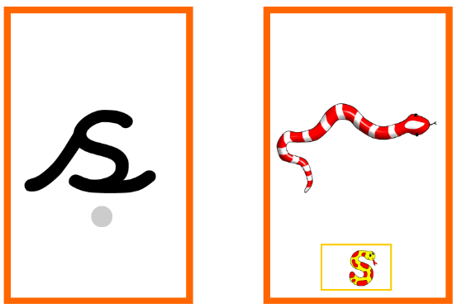
How to Say the Sounds 1.
Saying the sounds correctly is very important.
The way we say sounds now, may well be different from when you were at school.
The way we say sounds may also be different in various parts of the country depending on accents and dialects.
We also use jolly phonics actions and songs to support the children.

Slide 9
How to Say the Sounds 2.
https://www.youtube.com/watch?v=-ksblMiliA8
During phonics lessons, all children are taught age-related phonics for the first half of the session. They are then split into one of four ability groups to work on specific areas that have been identified through assessments.

Slide 10
Segmenting and Blending.
Segmenting is identifying the individual sounds in a word (him = h-i-m) and writing down the letters for each of the sounds in order to form the word.
Blending is recognising the letter sounds in a written word (c-u-p) and merging or synthesising them in the order in which they are written to pronounce the word (cup).

Slide 11
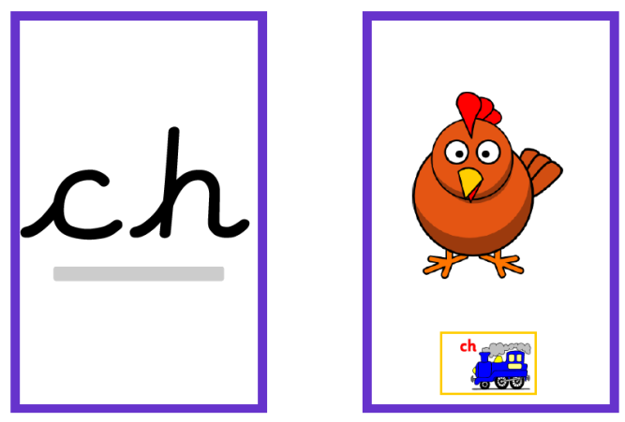
Phase Three.
The aim of phase three phonics is to recognise digraphs (this is when two letters make one sound) and use them when reading and writing more complex words, e.g. toad, feet, farm and pain.
Children are expected to read and write these words in simple sentences.

Slide 12
Daily Phonics 1.
Lessons are taught for about twenty minutes Tuesday-Friday.
We revise old sounds and teach new sounds every week, as well as high frequency words.
High frequency words (previously referred to as tricky words). These words can be decoded, but the children have not learnt all of the phonemes yet.
Examples of high frequency words include; me, was, my and you.

Slide 13
Daily Phonics 2.
Children are given lots of opportunities to practise known sounds when reading and writing during both indoor and outdoor play.
We use real objects to support learning, as well as flashcards with pictures to help children to remember.
We teach the letter sounds first as the letter sounds help children to become more successful early readers and writers.

Slide 14
Reading Books.
A ‘closely matched’ phonic book – a book that only contains the letters and the sounds that your child can recognise and start to segment and blend together.
A ‘reading for pleasure’ book – a book that your child can enjoy with you at home.
Books will be changed twice a week.

Slide 15
Reading Diaries 1.
After reading, please record this in your child’s reading diary.
You could initial that your child has read on a particular day.
Or write a comment about how your child found reading the book.
You may want to comment on whether your child enjoyed the book, if they found it easy or difficult, or use it as an opportunity to ask your child’s class teacher a question.

Slide 16
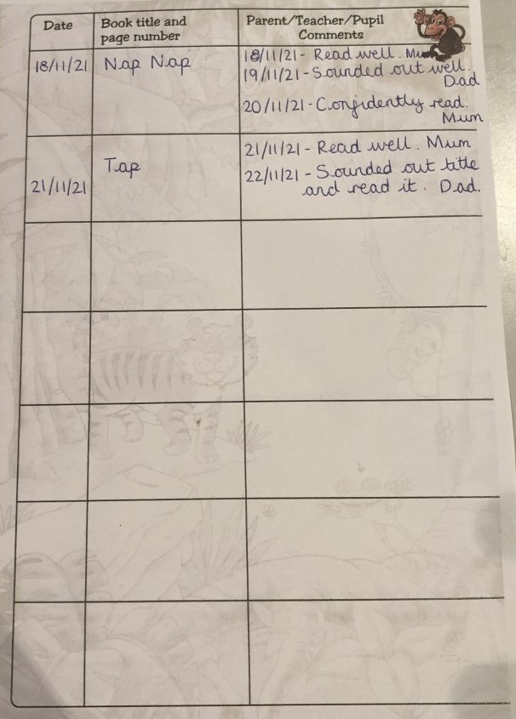
Reading Diaries 2.

Slide 17
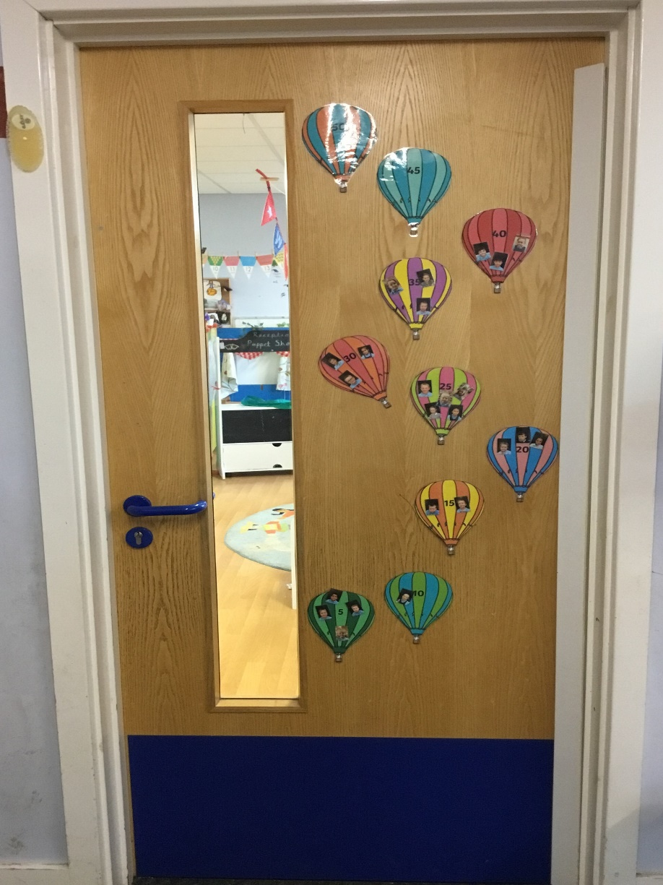
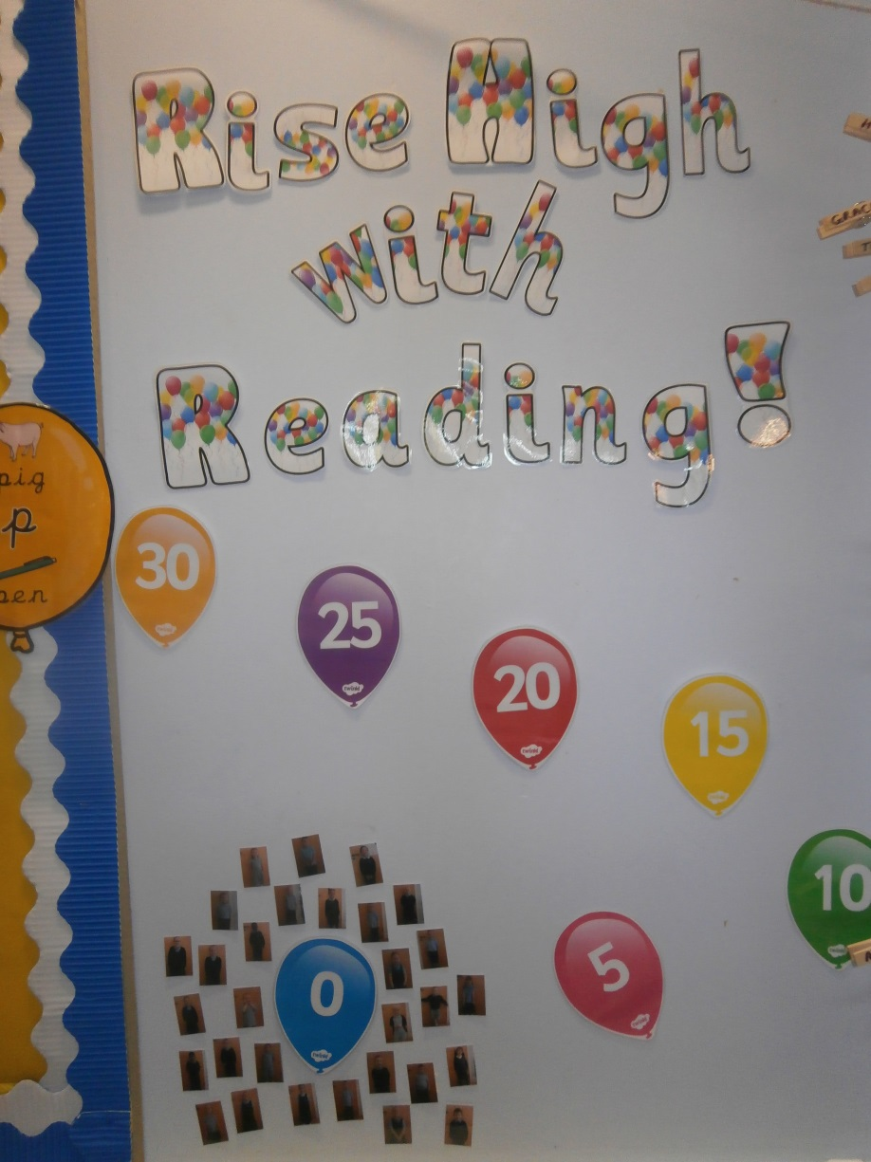
Reading - Robins.

Slide 18
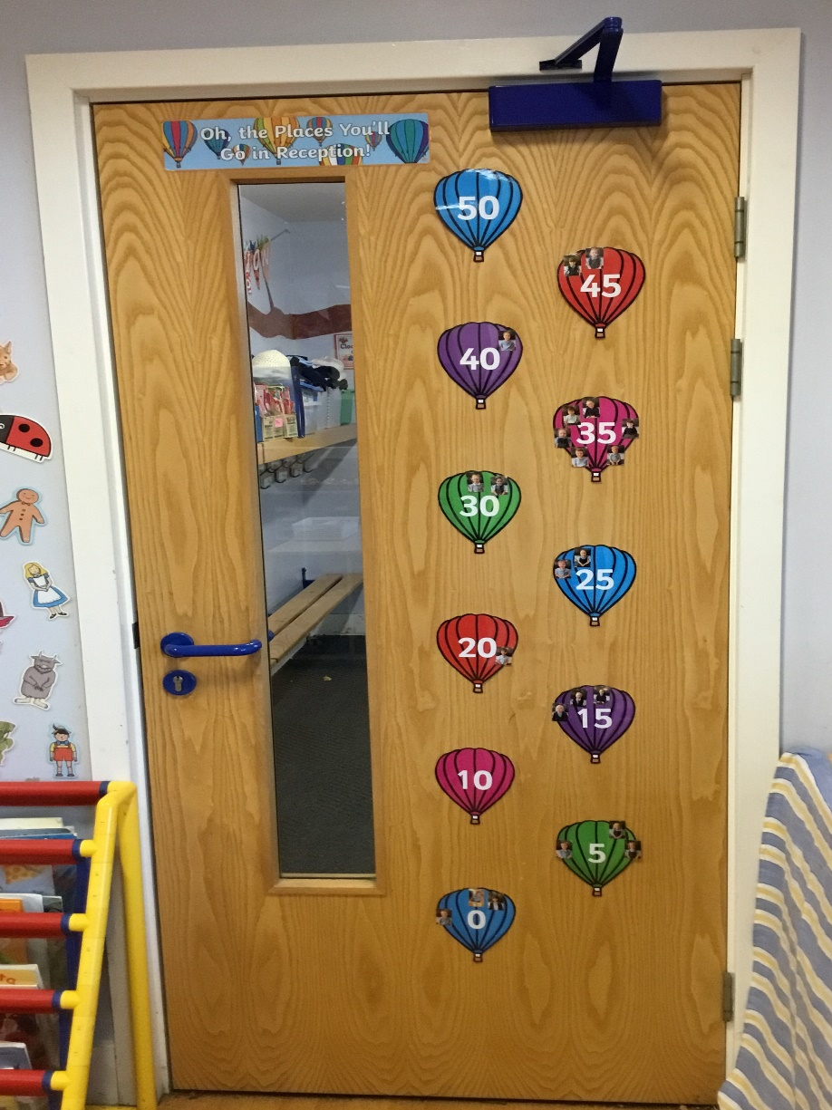
Reading - Wrens.

Slide 19
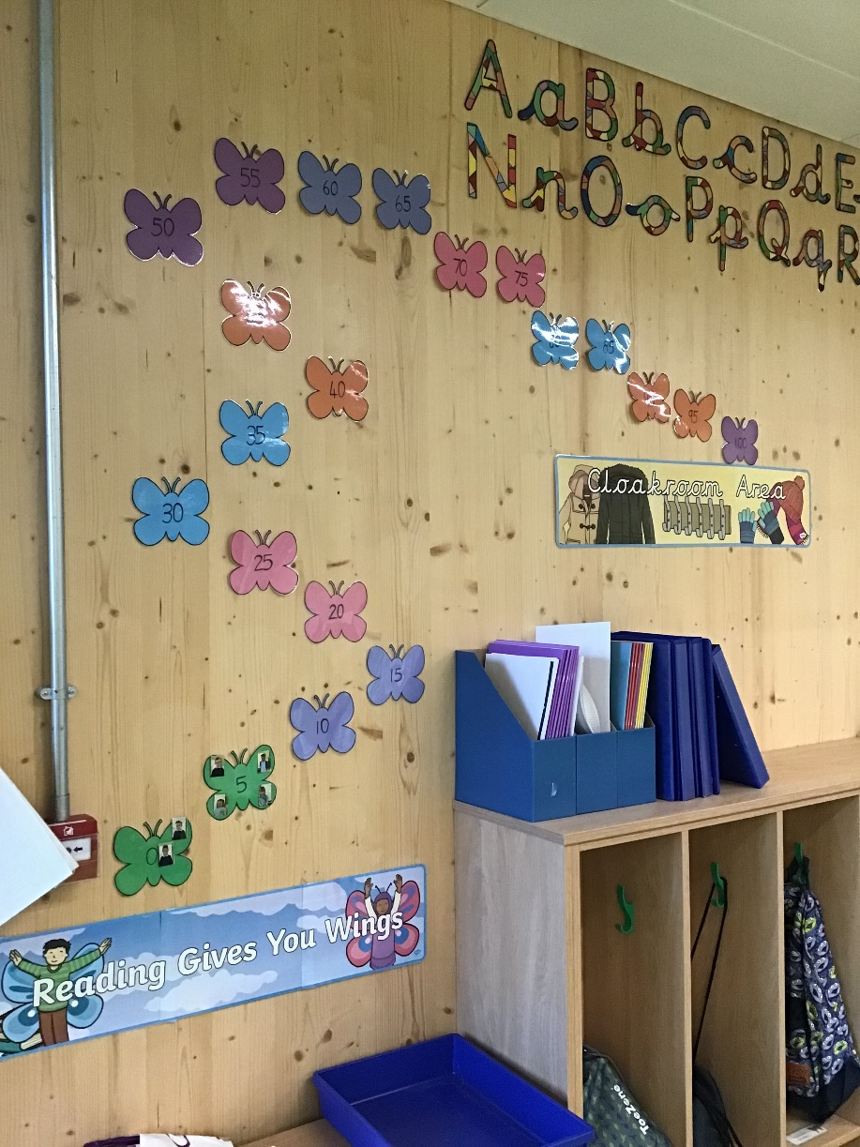
Reading - Wintringham.

