Slide 1
Kindness photo competition
Winners
December 2014

Slide 2
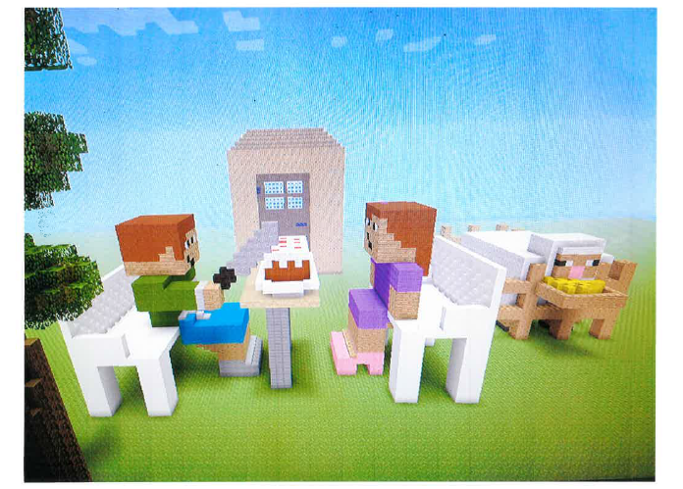
Runners Up: Harvey Bagley – Yr4

Slide 3

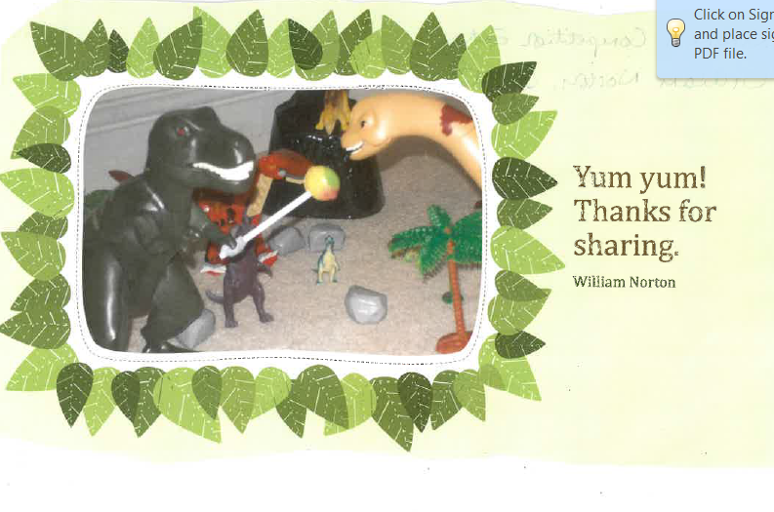
Anna Norton – Yr4
William Norton – Yr2

Slide 4

Apryl Jones –Yr4

Slide 5
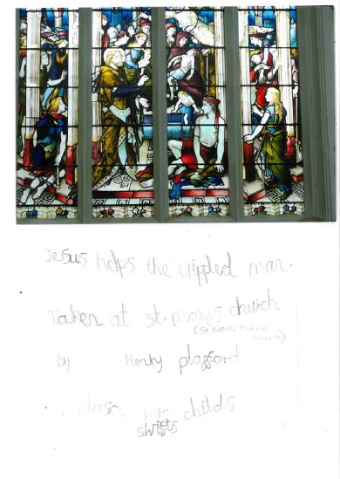
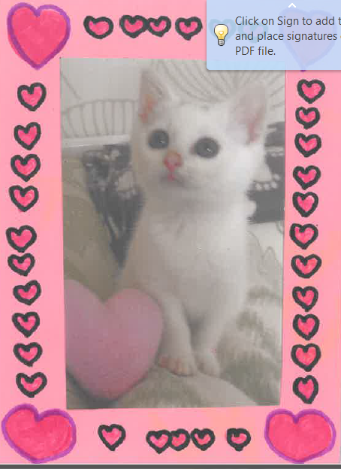
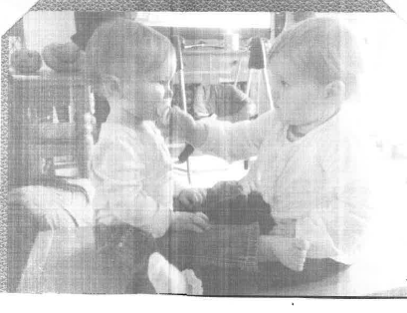
Henry Playford –Yr2
Amber Kendall – Yr6
John Colyn - Reception

Slide 6
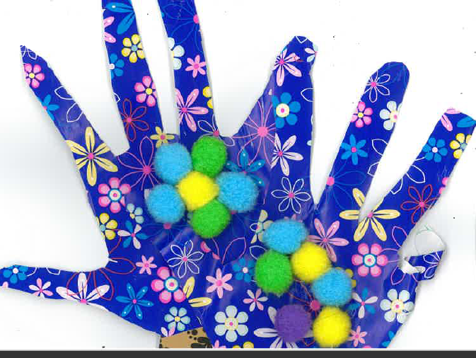
Madison Ledbury Yr6

Slide 7
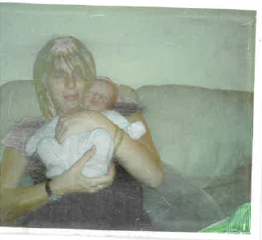
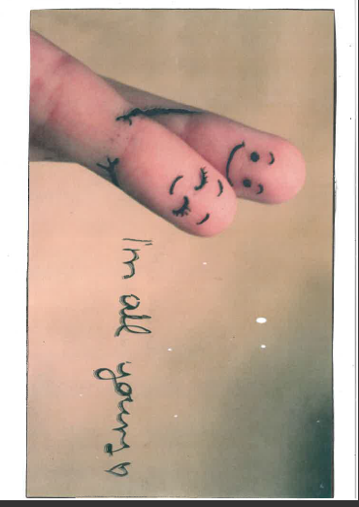
Freddie Wardman – Yr 3
Caitlyn Aird – Yr3

Slide 8
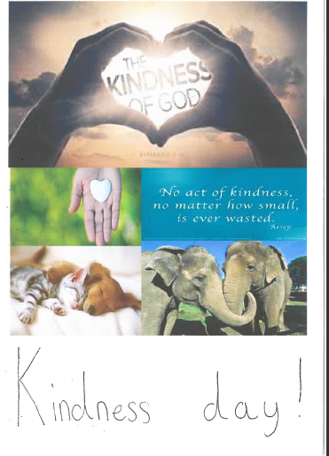
Ciara Mulvihill – Yr6

Slide 9
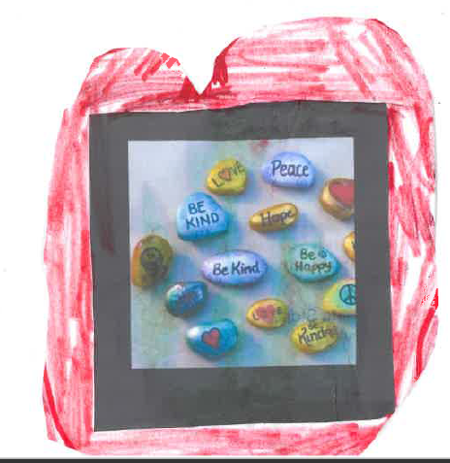
Sam Smith – Yr3

Slide 10
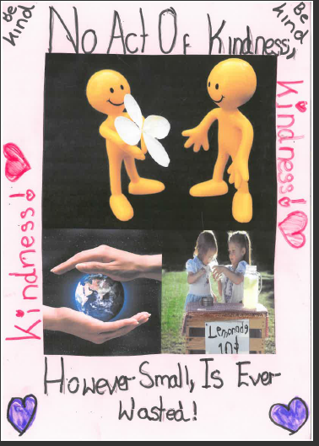
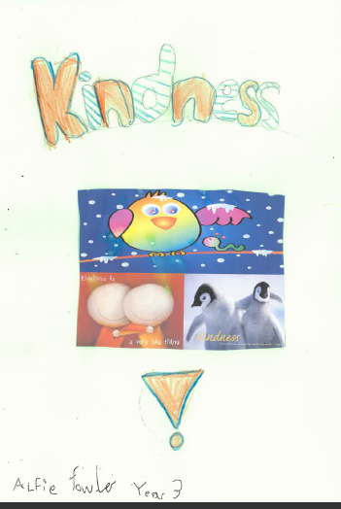
Amelia and Alfie Fowler Yr6/Yr3

Slide 11
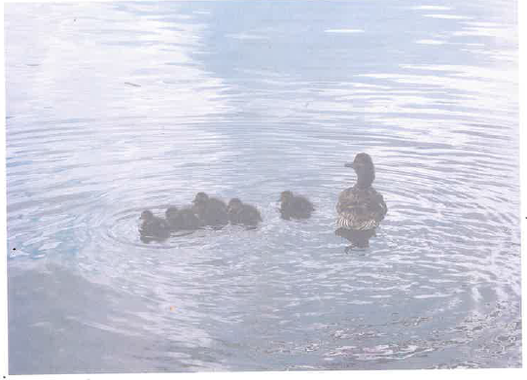
3rd
Lavinia Banas Yr3

Slide 12
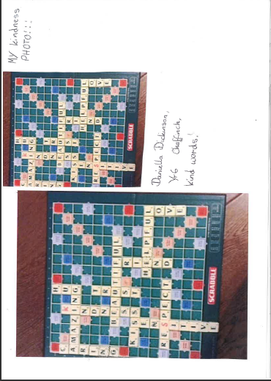
2nd
Daniella Dickinson – Yr6

Slide 13
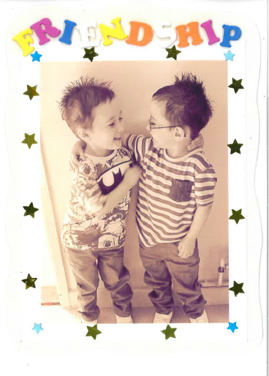
1st
Lucas and Lewis Findlay – Yr2

